Slide 1
Overview of eCourts/Tribunal Plan (WA)
Martin Jackson,
Acting Director, Strategic Business Development,
Court & Tribunal Services,
Department of Justice Western Australia

Slide 2
Vision
Part I: Vision – Describes the IT vision for Court and Tribunal Services; the business, technological and environmental drivers; the key principles that will guide delivery; and the plan’s alignment with departmental, whole of justice and broader governmental strategies and objectives.
Plan
Part II: Plan – Contains the roadmap for delivering the vision: the key service areas and programmes; and associated governance.
Initiatives
Part III: Initiatives – Gives an overview of each initiative; resource implications; and projected costs and benefits.

Slide 3
CHARACTERISTICS OF THE COURTS/TRIBUNALS OF THE FUTURE
Quality Outcomes
Timely Service
Responsiveness
Reasonable Cost
Provision of Information
Fair, Convenient Access

Slide 4
eCourts/Tribunal Vision
To provide online and remote services and integrated IT and audio visual solutions that enable a complete electronic record (eFile) of court proceedings to be created and shared with other justice agencies, legal firms and court users – creating a truly virtual court.
eCourts Strategic Plan
Courts Management
Minimise operational risk and ability to ‘stay in business’ through a continued legacy replacement program.
Deliver an electronic filing solution to realise the goal of a fully integrated electronic record.
Support legislative change.
Improve data quality by employing a data cleansing regime.
Enhance statistical & management reporting to drive and monitor Courts business.
Judicial
Upgrade or replace judicial systems with a contemporary solution.
Integrate judicial systems with ICMS for seamless court services.
Provide solutions to support collaboration across jurisdictions, committees and teams.
Facilitate consistency and openness in sentencing through the provision of a judicial sentencing solution
eBusiness
Expand eLodgement and Online forms to meet the growing demand for online services.
Enhance information services, paying particular attention to requirements of self-representing litigants etc.
Investigate and implement (where appropriate) innovative solutions to business needs.
Audio Visual
Continue to rollout AV equipment to support increased digital evidence, facilities for vulnerable witnesses and increased efficiencies and to lower security risks associated with transporting prisoners.
Ensure consistent AV standards across the State.
Maintain and refresh equipment in line with asset replacement guidelines.
Infrastructure
Eliminate performance issues associated with existing network communications, particularly in regional and remote areas.
Improve business continuity through the provision of Disaster Recovery / Failover Capability for ICMS
Improve productivity and reduce project costs through enhancement of the project delivery environments

Slide 5
Courts & Tribunals Strategic IT Plan 2015-2018
3. Capitalise in current and emerging technology
3.1 Implement the eCourts ICMS Criminal Project
eCourts Strategic Plan
A01 – ICMS Criminal √
A02 - ICMS FER √
A03 – Victim, Family Violence & Child Witness √
A04 – Criminal Injuries Δ
A05 – Coroners Court
3.2 Deliver an eFile
A06 – Jury Management
A07a – eFile
(DC Civil) √
A07b – eFile
(SC Civil) Δ
A07c – eFile
(Probate) Δ
A07d – eFile
(Appeal)
3.3 Upgrade or replace existing judicial systems
B01 - Judicial Systems Strategy √
C02a – eLodgment Civil
(DC) √
C02b – eLodgment Civil
(SC) Δ
C02c/C03a – eLodgment Civil & Online Forms (Probate) Δ
C01a/C02d – eLodgment Civil & Criminal
(Appeal)
3.4 Expand eLodgment & Online Forms
B02a - Judicial Systems (eBench) Δ
C02e / C03b eLodgment Civil & Online Forms (MC)
C01e / C03c eLodgment Criminal & Online Forms (MC)
C01f – eLodgment Criminal
(SC & DC Criminal)
C02f/C03d – eLodgment Civil & Online Forms (SAT)
3.5 Continue AV Rollout
B02b - Judicial Systems (Cause List)
A07e – eFile
(MC Civil)
A07f – eFile
(MC Criminal)
A07g – eFile
(SC & DC Criminal)
A07h – eFile
(SAT)
3.6 Enhance Network Communications
B03 – Judicial Sentencing Database
C04 – eCourts
Public Portal Δ
A08a– Technical Refresh
(Framework) Δ
A08b– Technical Refresh
(Application)
E02 – Disaster Recovery √
Inter-agency / Cross Justice
D01 – AV Integration & Upgrade Δ
A09 – Electronic Evidence
A10/11– Police Prosecutions & Custody Δ
D02 - Enhanced Video Conferencing Services
E01 - Shared Network
(Continued)
3.7 Use technology to support C&TS service delivery
KEY
Courts Management
Judicial
eBusiness
Audio Visual
Infrastructure
√ - Complete Δ - In Progress

Slide 6
WAPOL / DPP
PUBLIC
DCS / DOT
eCourt/Tribunal Portal (ICMS)
eLodgment
& Online Forms
Online Resolution
Court Requests, Witness Lists etc.
Time to Pay & Other Payments
Court Listings & Outcomes
eFile
Shared Justice Services
Evidence
Court Bookings
Bail
Conditions
ICMS
Supreme Court
Portal Access
eTrial
Portal Access
Decisions
State Administrative Tribunal
District Court
Judicial Resources
Magistrates Court
System to System
Messaging
Judicial eBench
Audio Visual & Digital Recording
System to System
Messaging
Children’s Court
Orders
Fines Enforcement
Coroners Court
Criminal Injuries
eFile / Book
Bring Ups
Probate
Victim Support, Family Violence & Child Witness
Jury Management
Prisoner Review Board
Infrastructure (Inc. shared infrastructure)

Slide 7
eTools for Courts and Tribunals
Most jurisdictions across Australia have the capability to accept the filing of documents electronically
Whilst this provides efficiencies in data entry the real benefits come from the ability for Courts and Tribunals to manage the entire process electronically and to make data readily accessible
In order to do this, the judiciary and administrative staff and users need a whole new tool set
Over the last couple of years we have started to develop some of these tools (Judicial eBench, eHearing Book, eCourts Portal)

Slide 8
eCourts Portal Functionality
GENERAL PUBLIC
OTHER PROSECUTING AUTHORITIES
eLodgment
(Prosecution Notices etc.)
Criminal Matters
(party to)
LAW FIRMS
eLodgment
(all jurisdictions, all divisions)
Court Listings
Infringement Lodgment & Withdrawal
Criminal Matters
WA POLICE
& ODPP
Criminal Matters
(all matters, all jurisdictions)
Infringement Lodgment & Withdrawal
OFFENDERS
Fine Payments
ENFORCEMENT AGENCIES
OTHER GOVERNMENT AGENCIES
Transcripts
Transcripts
Civil Enforcement Orders
Criminal Matters
(limited by offence, party, etc.)
Court Listings
eFile Access (party to matter)
Update Service Details
Criminal Enforcements
Online Lodgment
(all jurisdictions)
Payment Arrangements (TTP & SOE)
Online Dispute Resolution (SAT)
eFile Access (party to matter)

Slide 9
Portal Usage

Slide 10
Call Centre Usage

Slide 11
ICMS
eBench

Slide 12
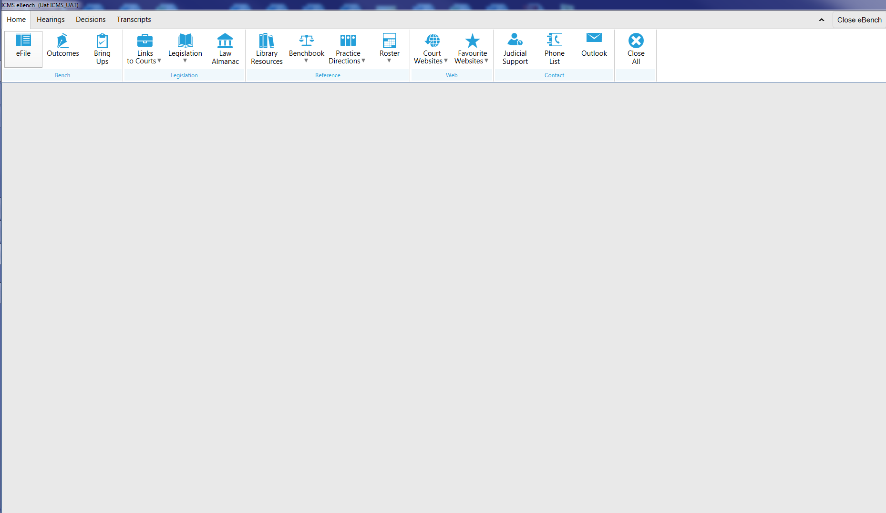

Slide 13
Viewing an eFile

Slide 14
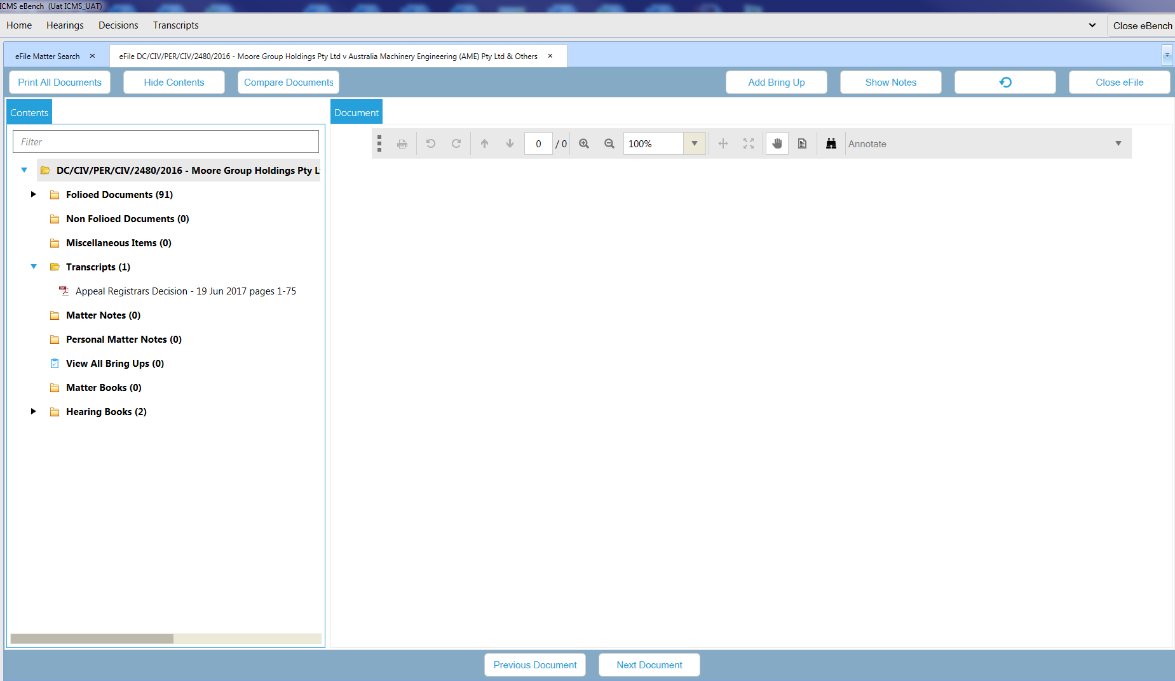

Slide 15
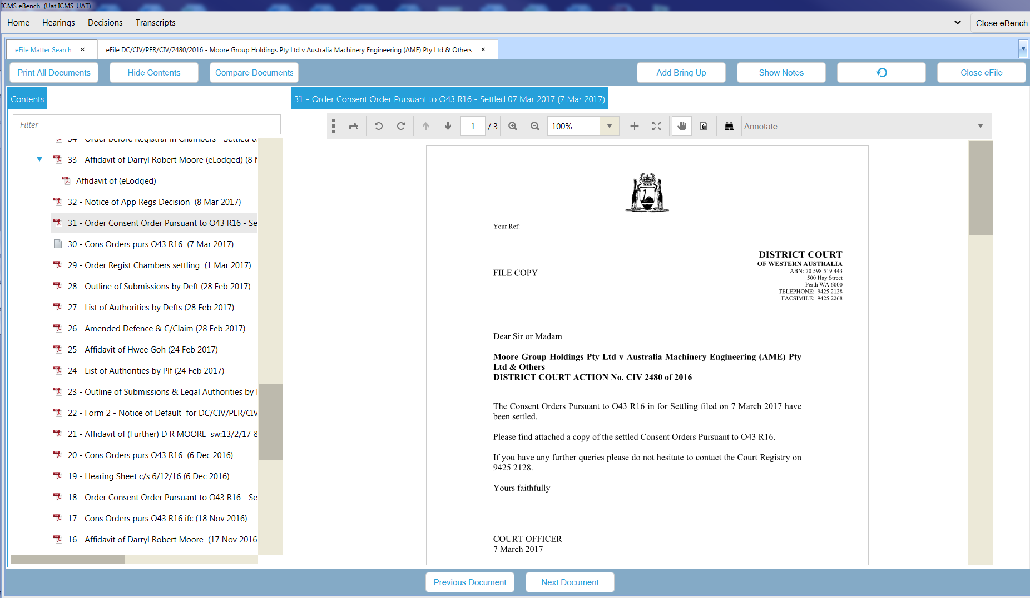

Slide 16
Contents:
Miscellaneous Items
Transcripts
Matter Notes
Personal Notes
Bring Ups
Matter
Hearing Books.

Slide 17
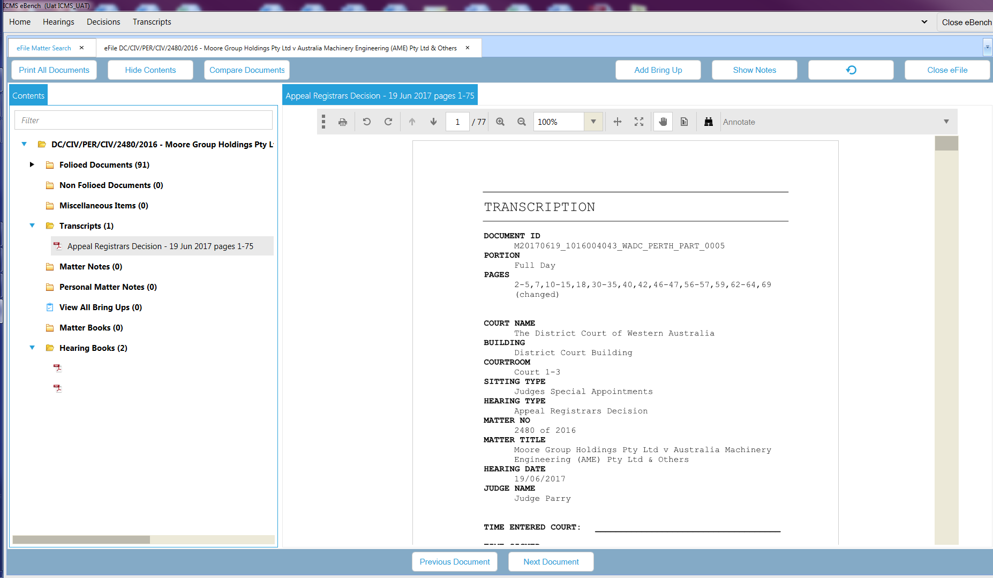

Slide 18
Can create, search and view decisions.

Slide 19
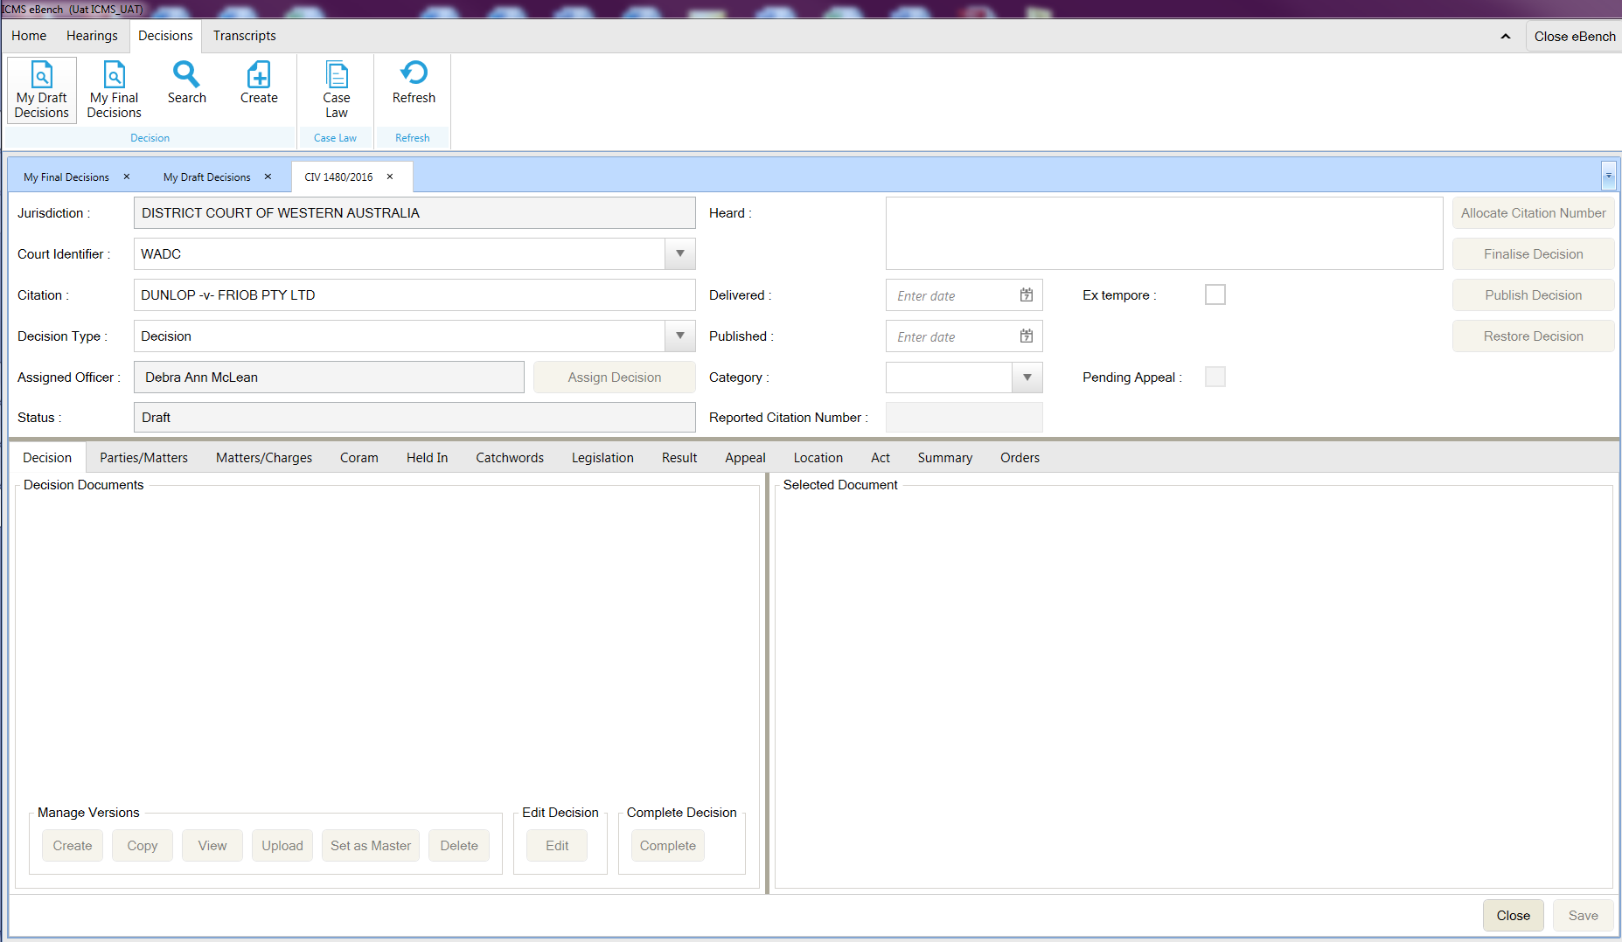

Slide 20
Calendar shows all Criminal and Civil lists

Slide 22
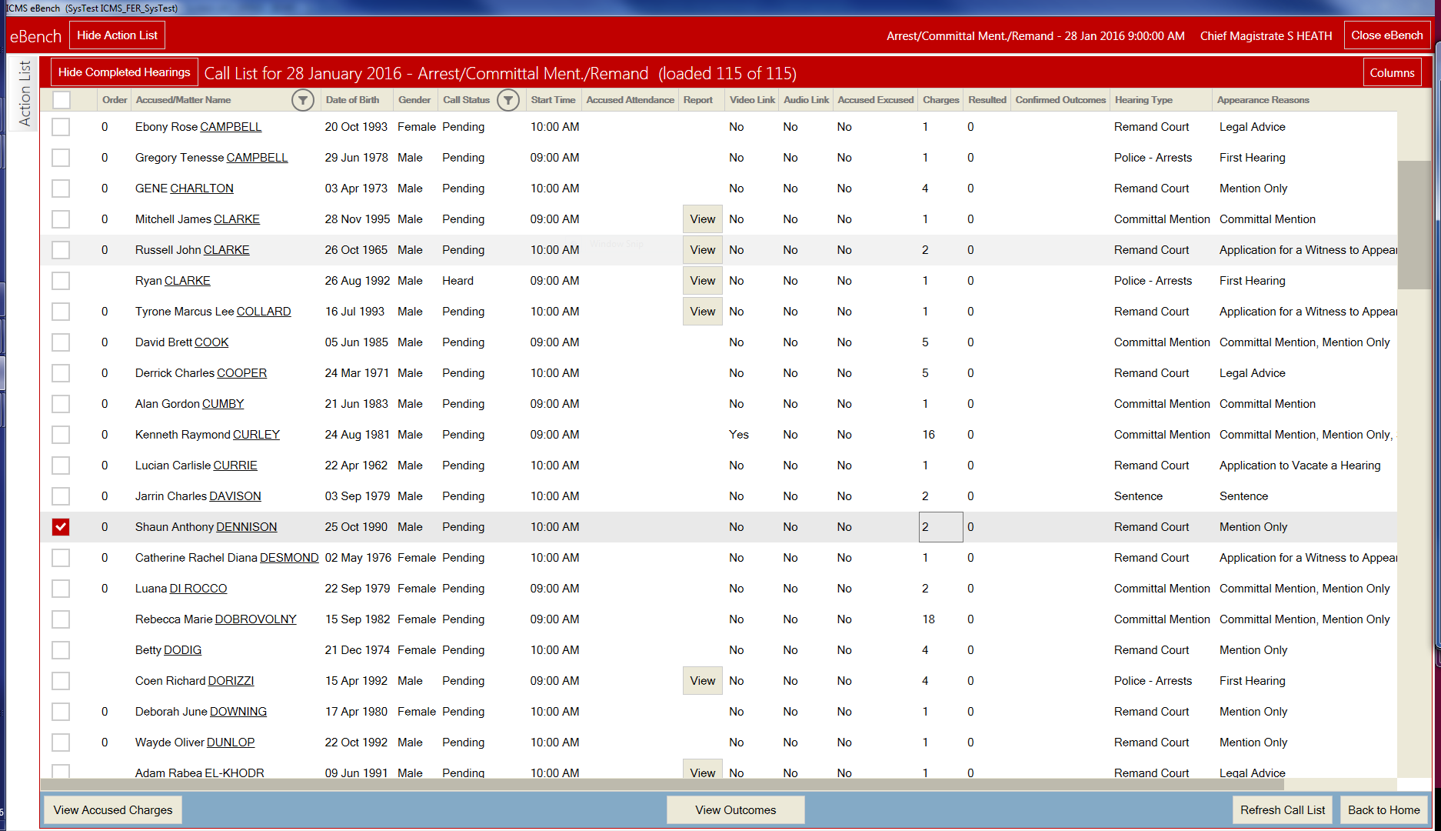

Slide 23
Ability to amend and extract Civil orders once confirmed

Slide 24
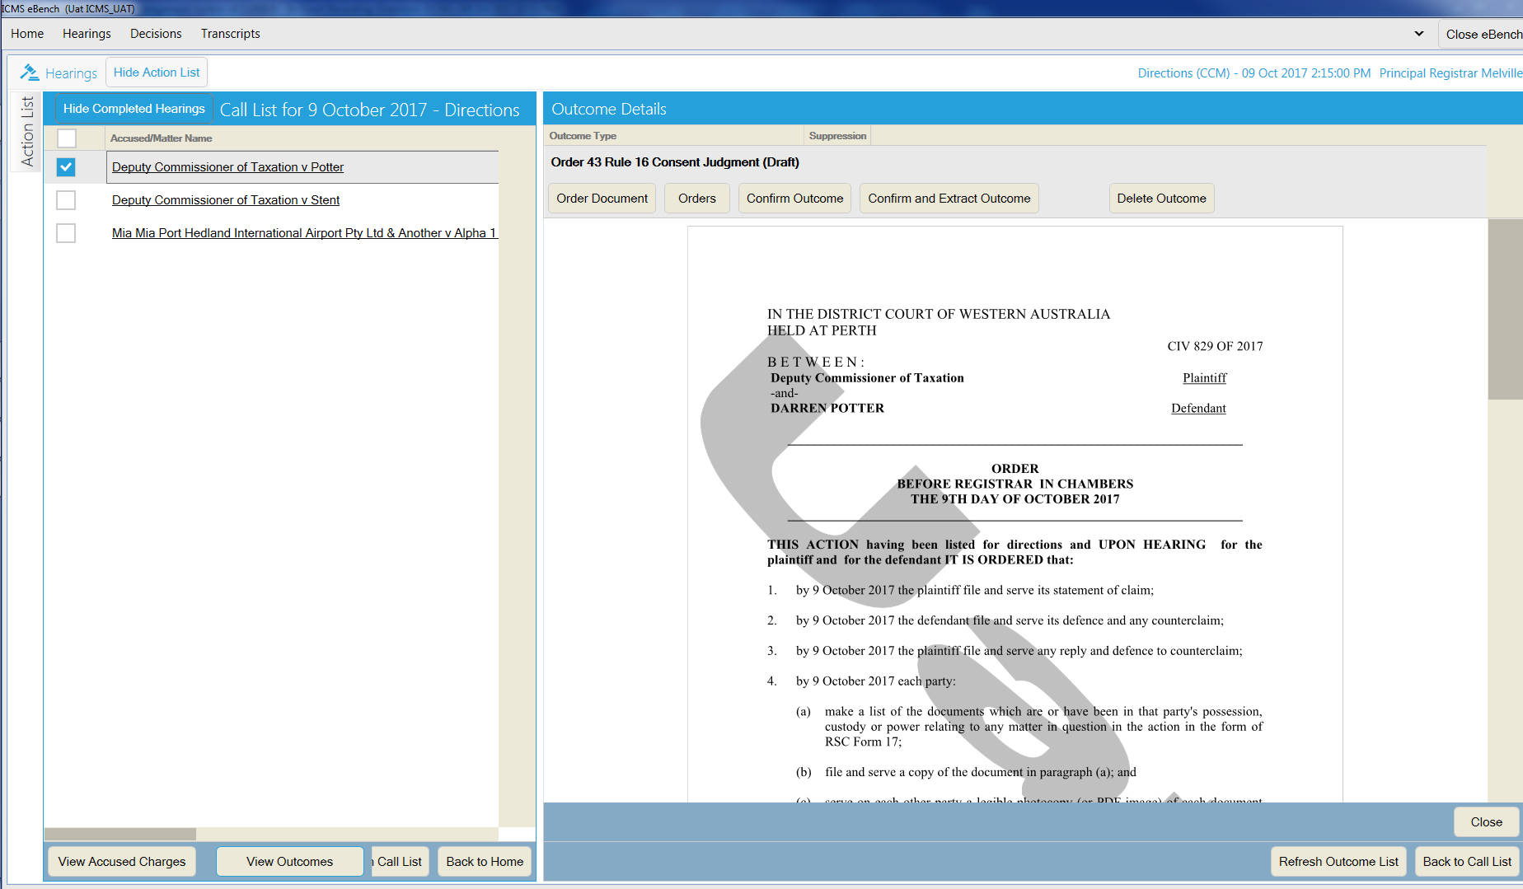

Slide 25
Questions?

