Slide 1
Safewards Victoria
Office of the Chief Mental Health Nurse, DHHS

Slide 2


Slide 3

Why Safewards?
A response to two high priority issues:
Restrictive interventions
Occupational violence
Supporting drivers:
Mental Health Act (2014)
Reducing Restrictive Interventions state-wide project
Reducing Restrictive Interventions Framework
Sector interest
Notes:
Lisa

Slide 4

Moving away from
Restrictive interventions
Fight response
Patient fear/ anger
Cultures of control
Staff
Fear/ anger
Fight response
Violence
Trauma
Illness / Injury
Occupational violence

Slide 5

Moving toward
Therapeutic interventions
Trust & hope
Patient safety
Cultures of care
Staff
safety
Trust & hope
Recovery
Safety
Learning
Connection & understanding

Slide 6

What is Safewards?

Slide 7
The Safewards basics
Model of practice for mental health settings
Focus on reducing conflict (violence & risk of harm) and containment (restrictive practices)
Solid evidence base (UK and Victoria)
Model and ten interventions
Implementation:
  2014-15 Pilot and evaluation
  2017-18 Implement in mental health inpatient units
  2019-20 Implement in EDs and general units

Slide 8
Conflict and Containment
Safewards centres around reducing conflict and containment
Conflict means anything that could lead to harm for the patient, other patients or staff:
Physical aggression
Verbal aggression
Self harm/ suicide
Substance misuse
Property damage
Absconding
Medication refusal
Containment (what staff do to prevent conflict events or minimise harmful outcomes) may include:
Special observation
Use of security
Physical restraint
Chemical restraint
Seclusion
Mechanical restraint
Environmental restraint
These behaviours could potentially lead to restrictive interventions

Slide 9
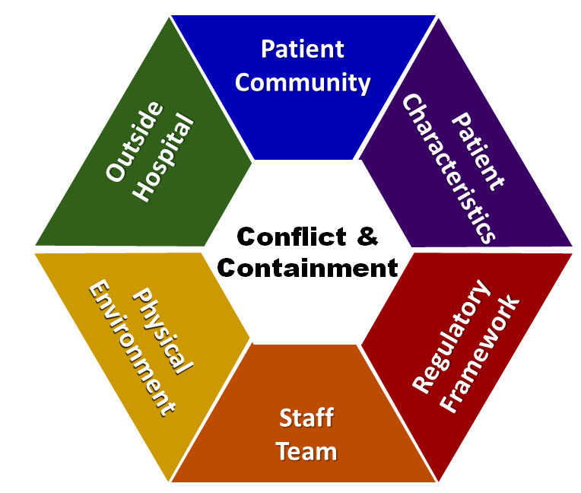
Technical Safewards Model & Interventions
Ten Interventions
Know each other
Clear mutual expectations
Discharge messages
Positive words
Soft words
Reassurance
Mutual help meeting
Bad news mitigation
Talk down methods
Calm down methods

Slide 10
Simple Safewards Model
Staff modifiers
Patient modifiers
Originating domains
Flashpoints
Conflict
Containment

Slide 11



The interventions
Originating domains
Know Each Other
Patients and staff share some limited personal information with each other.
Builds rapport, respect & common humanity
Clear Mutual Expectations
Patients & staff work out mutually agreed aspirations that apply to both groups equally.
Counters some power imbalances
Positive Words
Staff say something positive in handover re each patient, & use psychological explanations for challenging actions.
Increases positive appreciation and helpful information about working with patients.

Slide 12


The interventions
Patient Modifiers
Discharge Messages
Patients leave messages of hope for other patients.
Strengthens patient community & hope
Mutual Help Meeting
Patients offer and receive mutual help and support.
Strengthens patient community, coping

Slide 13



The interventions
Flashpoints
Reassurance
Staff debrief every patient after every conflict on the unit.
Increases patients’ sense of safety, reduces conflict
Bad News Mitigation
Staff understand, plan for & mitigate the effects of bad news received by patients
Reduces likelihood of conflict
Soft Words
Staff rethink limits on patients: reduce limits and/or increase options and respect in limit setting
Promotes respect, choice & dignity

Slide 14


The interventions
Conflict
Calm Down Methods
Staff use patient’s own strengths & coping strategies, or explore new ones, before using PRN medication.
Strengthen patient coping, skills, resources
Talk Down
Staff use consistent de-escalation process emphasising self-control, respect & empathy, with a focus on clarifying issues and finding resolution together.
Respect, mutually positive outcomes

Slide 15
Some practical ideas

Slide 16
Priorities for Tribunal staff
Common staff modifiers for staff:
Protecting the rights and dignity of people
Using supportive decision making (nominated persons)
Creating least restrictive environments and least restrictive practice (e.g. voluntary treatment)
Key interventions:
Positive words
Bad news mitigation
Know each other
Soft words
Talk Down
Calm down methods

Slide 17
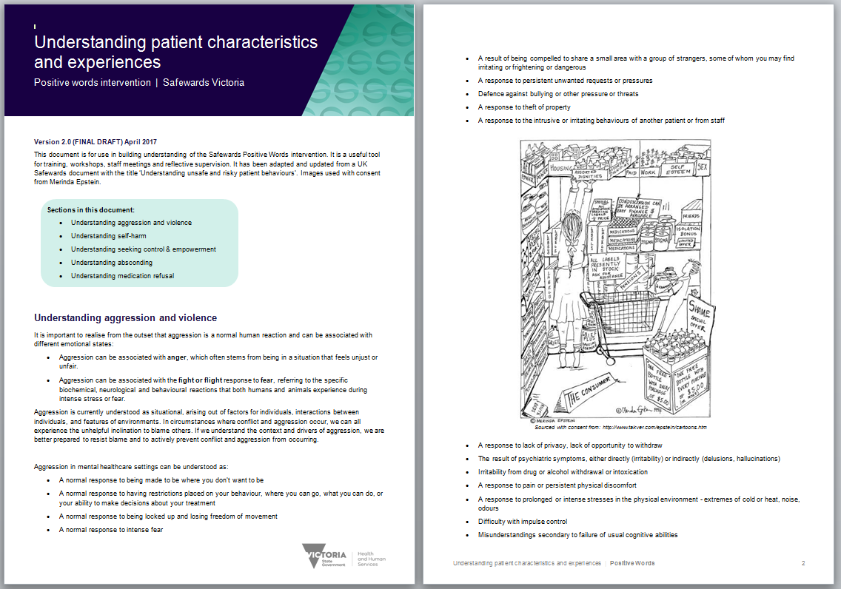
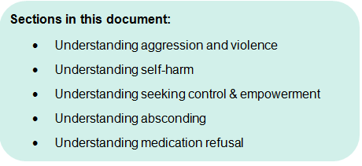

Positive Words
Staff say something positive in handover about each patient, & use psychological explanations for challenging actions.
Increases positive appreciation and helpful information about working with patients.
Supporting document: ‘Understanding patient characteristics and experiences’
Notes:
Provide a brief overview of what positive words is
http://www.safewards.net/interventions/positive-words

Slide 18

Bad News Mitigation
Staff understand, plan for & mitigate the effects of bad news received by patients
Reduces likelihood of conflict
Key messages:
Inform the team when you are giving news that might be upsetting
When delivering bad news, be respectful, provide as many choices as possible, give people time and space, offer ongoing support
If people get bad news from outside hospital, respond promptly & offer ongoing support
Notes:
Receiving bad news is common during an inpatient stay.
Bad news can be a flashpoint.

Slide 19
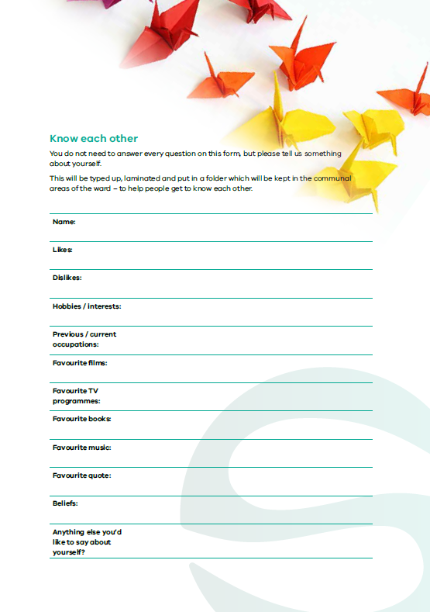
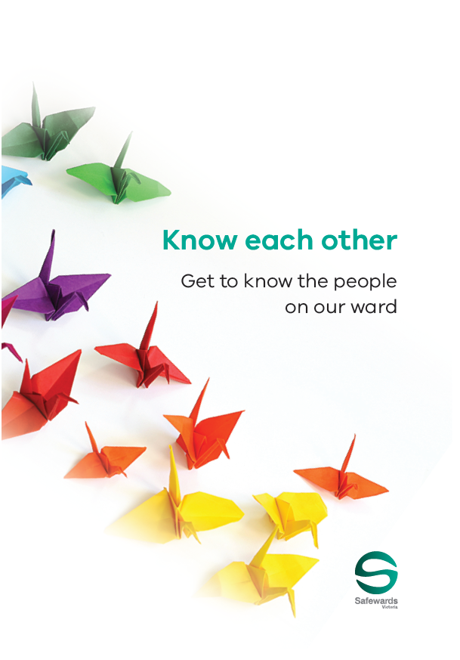
Know Each Other
Patients and staff share some limited personal information with each other.
Builds rapport, respect & common humanity
Know each other
Templates available
Notes:
Briefly explain Know Each Other
http://www.safewards.net/interventions/know-each-other

Slide 20

Soft Words
Staff rethink limits on patients: reduce limits and/or increase options and respect in limit setting
Promotes respect, control & dignity
Reduces likelihood of conflict
Key messages
Recognise that limits have an enormous impact – the most common flashpoint
Ask yourself first: Do you really need to set the limit?
Can you provide choice within the limits?
How can you maximise the person’s autonomy, dignity and human rights?

Slide 21
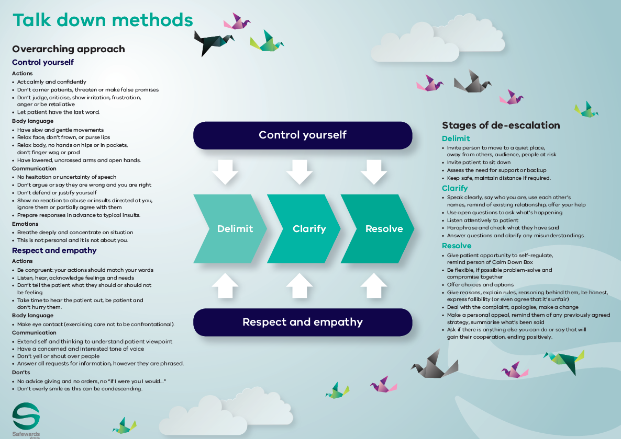

Talk Down
Staff use consistent de-escalation process emphasising self-control, respect & empathy, with a focus on clarifying issues and finding resolution together.
Respect, mutually
positive outcomes
Notes:
Briefly explain Talk Down-http://www.safewards.net/interventions/talk-down

Slide 22
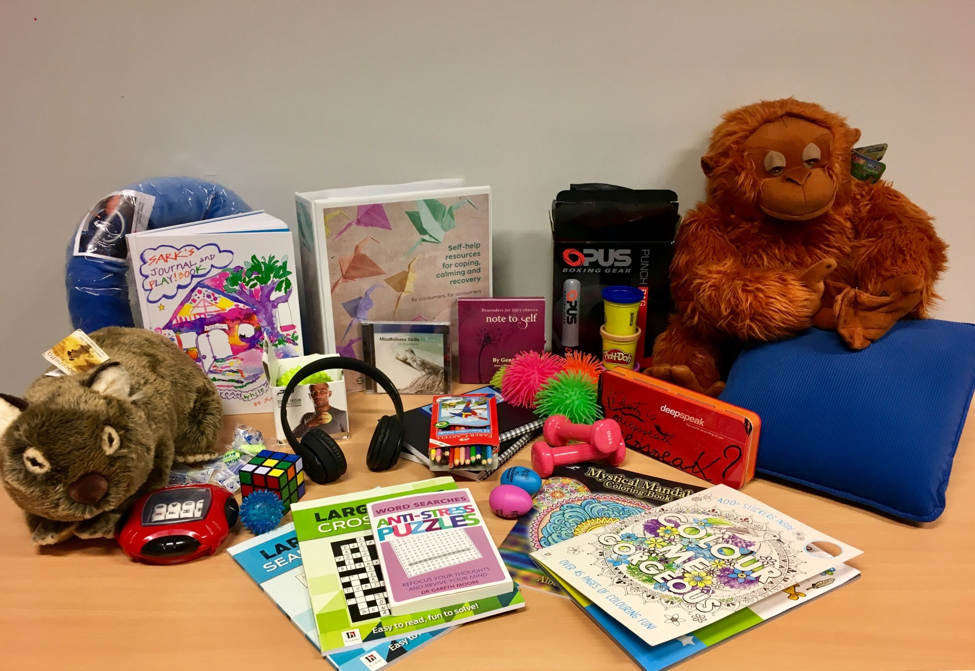
Calm Down Methods
Staff use patient’s own strengths & coping strategies, or explore new ones, before using PRN medication.
Strengthen patient coping, skills, resources
Key messages:
Think twice about PRN
Consider alternatives to medication that can be sustained post admission
Support people to draw on existing strengths & coping mechanisms
Facilitate learning of new strengths and skills

Slide 23
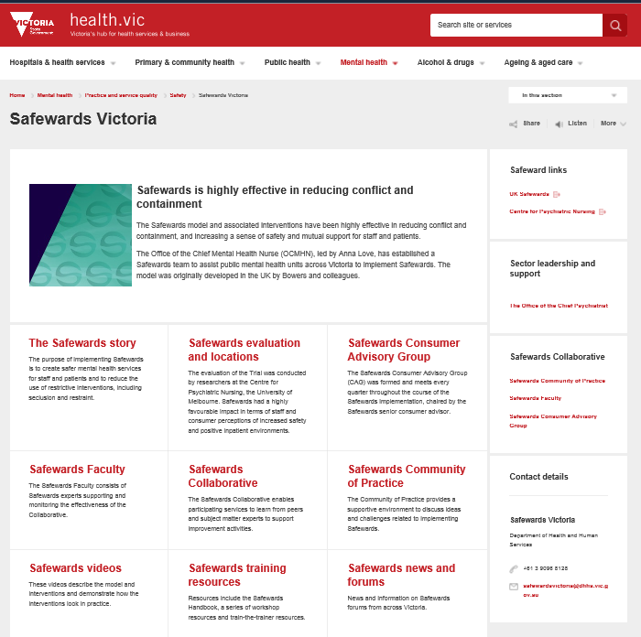

Find out more
www.health.vic.gov.au/safewards

Slide 24


