Slide 1
Leadership and effective management
  Strategic environment
  Vision and culture
  Engagement and accountability
  Govern to perform

Slide 2
Key AAT governance groups
Senior Leadership Group (members and staff)
Members Leadership Group (members) and Tribunal Executive Group (staff)
Accessibility Advisory Group
Interpreter Advisory Group
Transformation Program Steering Committee
    supported by Program Management Office

Slide 3
Strategic planning
AAT strategic objectives:
  create an integrated, national tribunal
  improve how we work and maximise our use of technology
  nurture relationships and partnerships
  make best use of our resources and build capacity

Slide 4
Public engagement and accountability
Public Affairs Advisor
Publication of decisions

Slide 5
Challenges
Separate streams for members and staff with overlapping areas of responsibility
Tension between local and national

Slide 6

Accessibility
Tribunal Excellence Framework
October 2017
Mary Shortland

Slide 7
Accessibility
The objects of the QCAT Act state the tribunal is to deal with matters in a way that is accessible, fair, just, economical, information and quick.
“Accessibility goes beyond the ease of obtaining physical access to the tribunal building but incorporates the ease of entry to the tribunal’s processes”.
Accessibility is fundamental to the user experience.

Slide 8
Key accessibility initiatives
Chatbot
Enhancing user experience using artificial intelligence in a growing jurisdiction
Online program
Online smart forms and fully integrated applications
Hospital hearings trial
Reducing guardianship hearing wait times by 70%
Accommodation upgrades
Increasing accessibility for our users

Slide 9
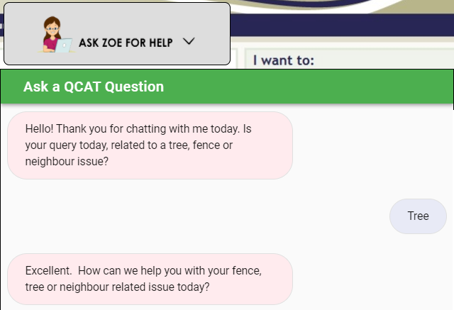
Chatbot
Before
Users make contact with multiple government agencies
and local councils to seek resolution in resolving
neighbourhood disputes, with mixed information and
lengthy delays.
After
We collaborated with an external partner to develop a Chatbot. Chatbots are a form of AI designed to simulate conversation with people over the internet and on mobile devices, and aims to:
✓ provide real-time responses 24/7
reduce user interactions with numerous agencies
reduce service delivery costs
Notes:
A Chatbot is a form of artificial intelligence designed to simulate conversation with people over the internet and on mobile devices. The innovation for this proof of concept is private sector and government collaborating to improve services to users, and the Department of Justice and Attorney-General (DJAG) leading Queensland Government in the delivery of the first artificial intelligent online service.
To further enhance solutions for users while managing a growing neighbourhood disputes jurisdiction, we are working together with the DJAG Digital Transformation Unit and Dispute Resolution Branch to develop a Chatbot with an external partner, who are funding the initiative.
The key feature of this Chatbot is it will provide a conversational interface and answer questions relating to neighbourhood disputes. The Chatbot will provide clients with real-time responses 24 hours a day, seven days a week. It will reduce service delivery costs and decrease user interactions with numerous agencies who support neighbourhood disputes, including courts, councils, real estate agents, law firms, and other government bodies.
A trial Chatbot has been released for in-house users (registry telephone staff) and following the trial, the Chatbot aims to be located on the QCAT website for access by our users 24/7, and has potential to be expanded across multiple jurisdictions in QCAT and other agencies.

Slide 10
Fully integrated minor debt
Before
After
Sealed copies returned within 7-10 days
Applicant downloads PDF, completes and prints
Applicant posts to QCAT
QCAT receive application, manually process payment and data enter
QCAT returns service copies by post
Applicant serves application
=
Applicant completes application, pays and submits online
QCAT receive application online – payment and data entry automatic
Sealed service copy automatically returned via email to applicant to serve
= No human intervention
= Sealed copies returned within 5 minutes
Improved user experience
Improved efficiencies
With over 6000 minor debt lodgements in Queensland the potential efficiencies are significant
Notes:
QCAT are progressively moving PDF forms to online smart forms developed in-house in conjunction with the Digital Transformation Unit. We currently have 11 online services providing:
easy navigation through form content;
help text on instructions for completing throughout the online service;
faster turnaround - sealed copies can be emailed;
automatic data validation to ensure documents are correct at application point; if they aren't eligible to use the form online, they can't continue; and
as part of our commitment to accessibility, the PDF versions of forms will be retained.
Our biggest initiative in this space is the implementation of a 3 month trial in Brisbane of our first fully integrated application. The launch of our application for minor civil dispute – minor debt in June provides parties with the same options for our other online services, but also enables parties to:
pay the relevant filing fee through our secure shopping cart;
submit the application online; and
Receive a sealed application with a case number automatically to them via email.
As part of this integration, our case management system CLAIMS is automatically updated with all relevant party details, removing the need for data entry by registry staff. This service provides a more accessible service to our users in one of our largest jurisdictions, with sealed service copies returned within 5 minutes via email instead of post, reducing the time from 7-10 days.

Slide 11
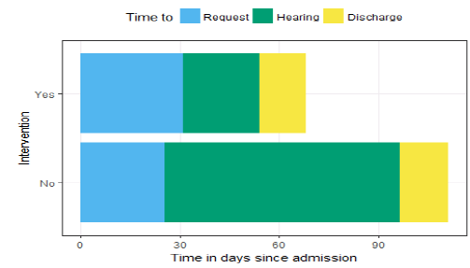
Hospital hearings
After
Collaboration with MNHHS
70% reduction in guardianship hearing wait times in hospitals
45% reduction in times to discharge for adults
Increased bed capacity
=
=
Before
Limited bed capacity
Reduced quality of care
Increased costs
Lengthy delays for hearing
Lengthy times of discharge
Notes:
During the past five years, approximately 1,200 vulnerable Queenslanders with impaired decision making capacity experienced lengthy stays in Metro North Hospital and Health Service (MNHHS) beds while they awaited substitute decision-makers appointments through QCAT. This impacted QCAT with an increase in interim order applications, and process times for guardianship matters increasing.
This resulted in service cost increases for Queensland Health and QCAT, and reduction in quality of care. In 2016-17, QCAT and MNHHS worked together to redesign the guardianship application process and reduce these wait times.
Over the course of the trial, we worked with Queensland Health to:
create additional hearings and dedicated QCAT hearing days solely for MNHHS patients;
develop a more patient-centred experience, with justice services delivered to the patient’s bedside;
assign and train QCAT and MNHHS staff to coordinate and manage guardianship applications;
educate and support Queensland Health’s new QCAT social work coordinator role; and
establish process standardisation resources across MNHHS facilities.
The trial has resulted in a 70% reduction in guardianship hearing wait times in hospitals, and trial outcomes were assessed quantitatively by calculating the number of hearings, hearing timeframes, additional bed capacity and return on investment. Qualitative stakeholder feedback is largely positive and reinforced the importance of QCAT’s close relationships with Queensland Health and aged care facilities.
It is estimated that as at end September 2017, the trial provided MNHHS with 7,263 days of bed capacity, saving over $7.5 million, and has resulted in the trial’s extension to September 2017. It is hoped other Queensland Health Hospital and Health Service areas will partner with QCAT in 2017-18 to progressively extend the trial’s benefits state-wide.

Slide 12
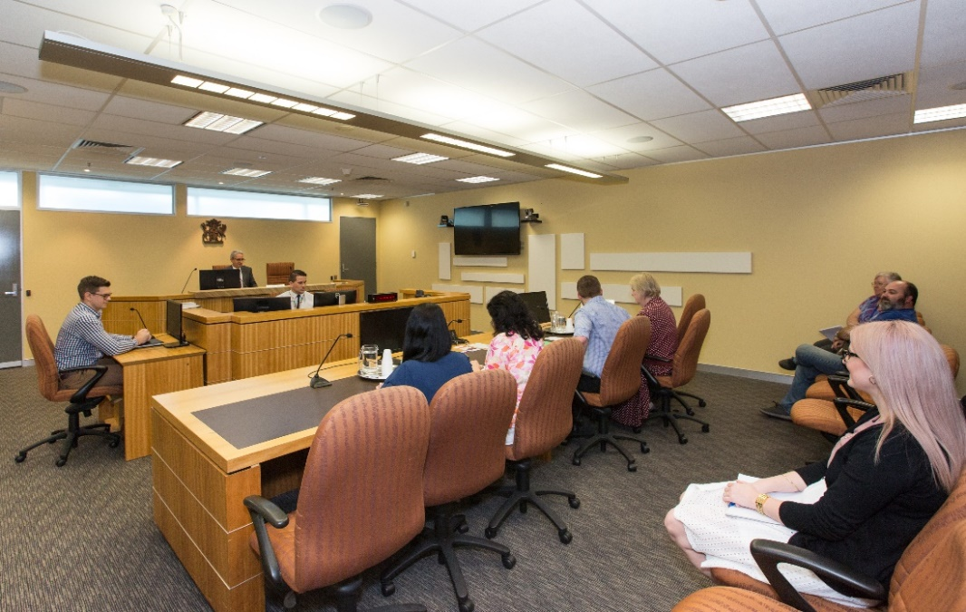
Accommodation
Before
Outdated hearing rooms
Limited telephone and video-conferencing
facilities
After
Fit-for-purpose hearing rooms
Enhanced accessibility through telephone and video-conferencing in all upgraded rooms
More accessible counter facilities including electronic form and document submission
Overall improvement to the user experience
Notes:
QCAT recently completed upgrades to hearing and mediation rooms in our Brisbane registry to provide better accessibility to users attending in person, and via telephone and video-conferencing.
QCAT provide ongoing accommodation for LawRight and Court Network Volunteers to provide accessible assistance for self-represented users, and are reviewing requirements to reintroduce Tenants Union Queensland and the introduction of a Duty Lawyer Scheme to be accommodated in the Brisbane registry.
Further accommodation works are being planned to enhance accessibility for users at our Brisbane registry counter, and provide services to allow self-represented parties to access QCAT information and provide options for electronic form and document submission.

Slide 13
Further accessibility initiatives
QCAT’s other accessibility initiatives include:
  e-Mediation
  Online guided resolution
These initiatives will be presented later on at the conference.

Slide 14

Client needs and satisfaction
Tribunal Excellence Framework
October 2017

Slide 15
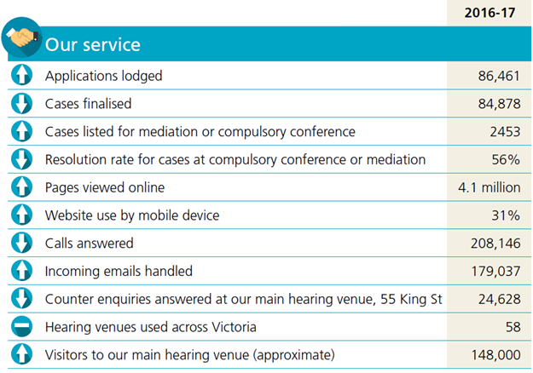
Service snapshot

Slide 16
Why tribunals exist
“It should never be forgotten that tribunals exist for users, and not the other way round.
No matter how good tribunals may be, they do not fulfil their function unless they are accessible by the people who want to use them ...”
Sir Andrew Leggatt 2001
International Framework for Tribunal Excellence

Slide 17
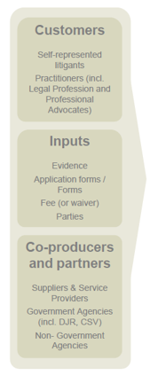
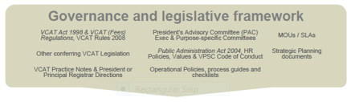

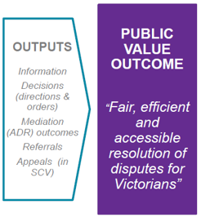
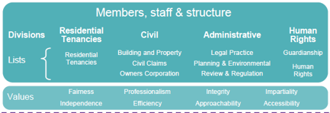
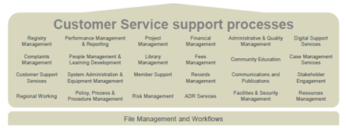
Our public value statement

Slide 18
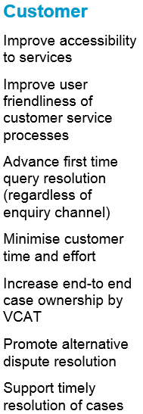
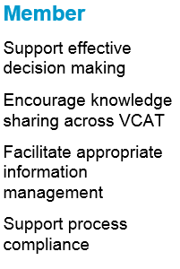
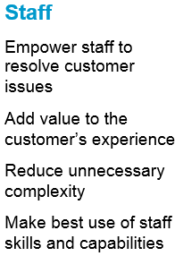
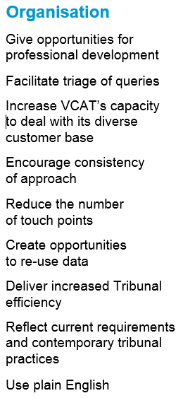
Key design principles

Slide 19
Key service enhancements
Customer Service Improvement Program
Streamline registry processes across the tribunal
Single phone number, call reason codes, establish professional contact centre
Customer Service Framework, including customer satisfaction surveys & public reporting
Digital strategy
Electronic lodgement, electronic files
User-centric website
vcat.vic.gov.au
Inclusion
Accessibility Action Plan (aligns with State Disability Action Plan)
Koori Inclusion Action Plan
Expand access to alternative dispute resolution
Including Online Dispute Resolution pilot

