Slide 1
Ex tempore decisions
Or saving your sanity
A reflection by Lorraine Walker,
Chief Magistrate and Chief Coroner of the Australian Capital Territory

Slide 2

Why?
the parties’ needs
institutional efficiency
your sanity

Slide 3
Why not?
You do not know the correct outcome
You simply cannot do justice to the evidence/the issues raised without reflection/time
The issue has wide significance
A circuit breaker is required – whether for a party or for you

Slide 4
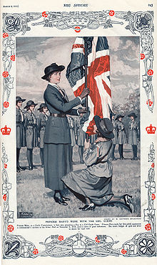
But just in case….
honour the Girl Guides code and “be prepared”

Slide 5

Factors in preparation
Notice: docket, list , hospital pass
Time available in advance
Risk analysis – will it run?
How long will it run – on the go prep?

Slide 6


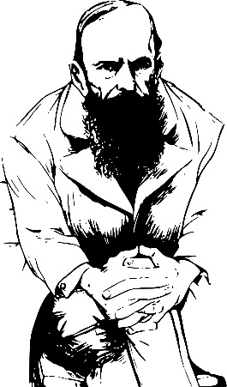
The case type
The (almost) blank page: Charge sheet self-rep application | The tantalising mystery Basic pleadings Preliminary applications | The Dostoevsky novel Multiple pleadings and applications in proceedings; volumious documents – affidavits; T documents

Slide 7

The first fork in the road…

Slide 8
Preparing for the possibility
Highly likely
Open a document
Put in the basic knowns
Prepare a structure by headings
Insert known legal principles which will or may have application
Issues which may arise on information available to you.
You may choose to have a number of template documents
Never wasted – same for reserved decision

Slide 9
Decision-makers battle brief
The hearing book
The tools
NOT a tear off note pad
exercise spiral/hard back book
Two way lines
iPad/laptop?
Chronology- dates or times
Likely exhibit list?
Coloured pens
Sticky tabs!!!
Template document
"Cheat sheets" for different issues
Relevant texts/legislation etc – excerpts?

Slide 10
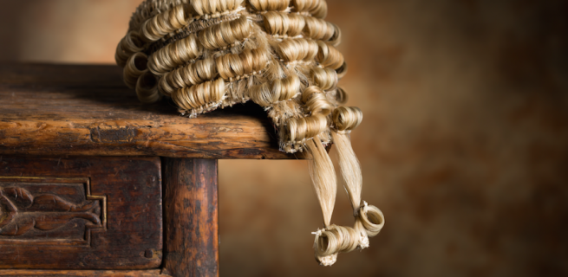
Personal preparation
Physical
Psychological

Slide 11
Extracting your pound of flesh
(or requiring the parties to do their job)
Before the hearing:
  Targetted case management
  Notices to admit or equivalent
The opening address
  Clarification
  Narrowing the issues
  Confirm agreements – in writing or on the record

Slide 12
In the hearing
Controlling the flow
Require copies of documents to annotate
Confirming relevance
Requiring the parties to “pin their colours to the mast”
Confirming your understanding of their positions
Inviting written summaries as part of oral closing submissions

Slide 13
Revisit- should you reserve?
Do not hedge your bets by announcing the decision but reserving your reasons- if you are so certain, explain why; tidy up for publication if necessary
If unsure whether or not to reserve, take a brief adjournment to determine that issue primarily – a stitch in time is still worth nine
If you must reserve, set a date for delivery of decision

Slide 14
Delivery - I
Immediate or a little later; on or off the bench
Simple language, scope for imagery, and personality, but rarely humour
Active voiced, conversational, avoid double negatives
Communicate with your audience
Announce the decision: at the outset? Or the end? Or both?

Slide 15
Lloyd’s Bank v Bundy [1975] 1 QB 326
Broadchalke is one of the most pleasing villages in England. Old Herbert Bundy was a farmer there. His home was at Yew Tree farm. It went back for 300 years. His family had been there for generations. It was his only asset. But he did a very foolish thing. He mortgaged it to the bank. Up to the very hilt. Not to borrow money for himself but for the sake of his son. Now the bank have come down on him. They have foreclosed. They want him to get out of Yew Tree Farm and to sell it. They have brought this action against him for possession. Going out means ruin for him...now there is an appeal to this court. The ground is that the circumstances were so exceptional that Herbert Bundy should not be held bound.

Slide 16
Delivery II
Use names rather than party descriptor (mostly)
Use of headings
Only address what you need to-law which is not settled, facts which are in dispute and essential to the decision
Slower pace- allows thought, adjustment, careful expression, reference to notes
Be sure to address the losing party’s (potential appellant!) position

Slide 17
https://Letting emotion do the talking - or what you might really like to say!

Slide 18
Corrections
“Guide to judicial conduct“ by the Council of Chief Justices
Cannot alter the substance
May revise reasons if a slip means what was said was not what was intended or is poorly expressed
Correct grammatical errors
Add case references and citations

Slide 19
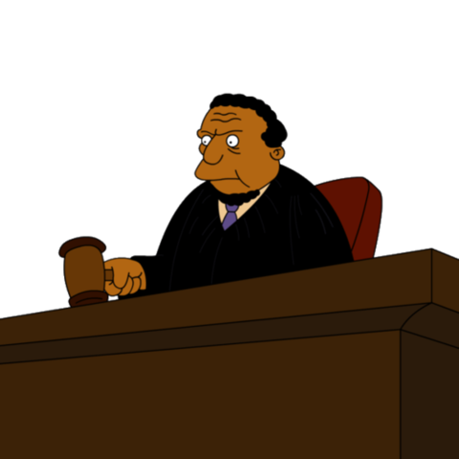
Are you ready?
“an accurate recall of the detail of relevant evidence and a clear perception of applicable principles of law afford the best foundations for proceeding to an ex tempore judgment which is convincing” Justice Michael Kirby Western Australia Law Review [Vol 25] Dec 1995 213

Slide 20
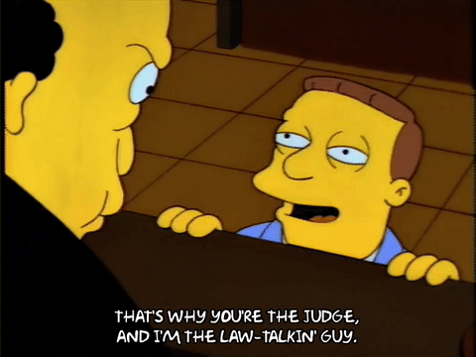
Your practice, your way
Prepare
Practice
Reflect
Refine

