Slide 1

Diversity & Indigenous Clients
Roula Karzis-Wyatt Team Leader
Ian Phillips Registry Manager
AAT Adelaide Registry
(Warning: Aboriginal and Torres Strait Islander readers should be aware that this document may contain images or names of people who have since passed away)

Slide 2
Are we reaching the Indigenous and Rural Community?
exploring service delivery models to address the needs of indigenous/ rural communities
to improve access to justice
Strategies undertaken by AAT/ SSAT

Slide 3
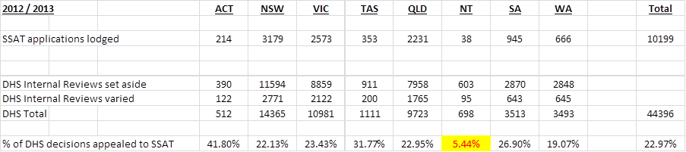
Disparity in access- 2012/13

Slide 4
Seeking review
the ability of an individual to seek review depends on a person’s circumstance (including motivation & personal resources) as well as:
  Knowledge of review rights, entitlement, obligations and responsibilities;
  Awareness of systems for redress;
  Ability to effectively access avenues for redress; and
  Ability to effectively to participate in the processes

Slide 5
National Multi-layer Outreach plan 2013-14
inform citizens, community groups, welfare and legal advisors about the
  Tribunal and procedures
  empower users to prepare and present their cases
increase the public’s understanding of tribunals in the civil justice system and the AAT/SSAT Tribunal in particular
increase knowledge of AAT/SSAT Tribunal to both socially and geographically isolated or disadvantaged communities and the workers and others who assist these communities.

Slide 6
Specific target
increase awareness within
  Indigenous communities,
  Culturally and Linguistically Diverse Communities,
  People with mental health issues,
  People with disabilities, and
  People who live in rural and remote areas

Slide 7
Challenges to overcome
Cultural and language barriers that inhibit the remote indigenous communities from accessing processes of review
Service providers had advised that forming relationships is key to successfully communicating with the Communities.
there are cultural barriers that inhibit indigenous communities from accessing the review process.
a lack of accessible information, a reluctance to raise queries with Centrelink for fear of reprisals or some type of negative impact.

Slide 8
SA experience
Each state registry had their own “outreach” strategies
SA has been one of the most energetic registries for “outreach”
SA- Formation of a strategic alliance between:
  Welfare Rights Inc.
  AAT (General Division)
  Brain Injury Network SA
  Right Foundation
  The Wyatt Foundation
  Centrelink
Key relationships to establish network with suppliers of services to indigenous and remote community groups

Slide 9
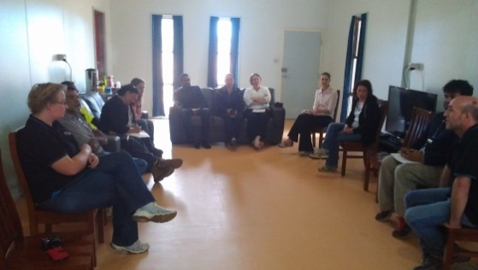
Working with Service providers
“Train the trainer”
Greatest coverage in spreading the word
Keeping the message simple and clear
Work shopping situations
Tapping into professional development training sessions for the service providers and being part of accredited professional educational training
Service provider meeting Fregon

Slide 10
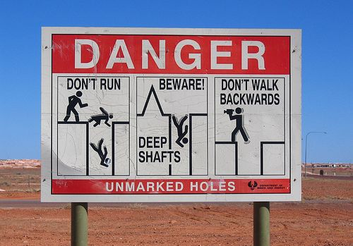
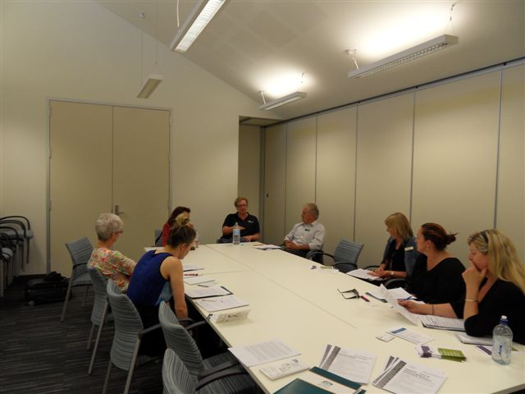
Engagement
APY lands, Coober Pedy, Riverland, Murray Bridge, Ceduna, Port Pirie, Whyalla, Pt Augusta, Pt Lincoln, Broken Hill
Disability and Ageing Expo
Mental Health Rights Forums
Aboriginal Health Workers Forums
Metro rural and remote community forums
Homelessness Expo (Adelaide)

Slide 11
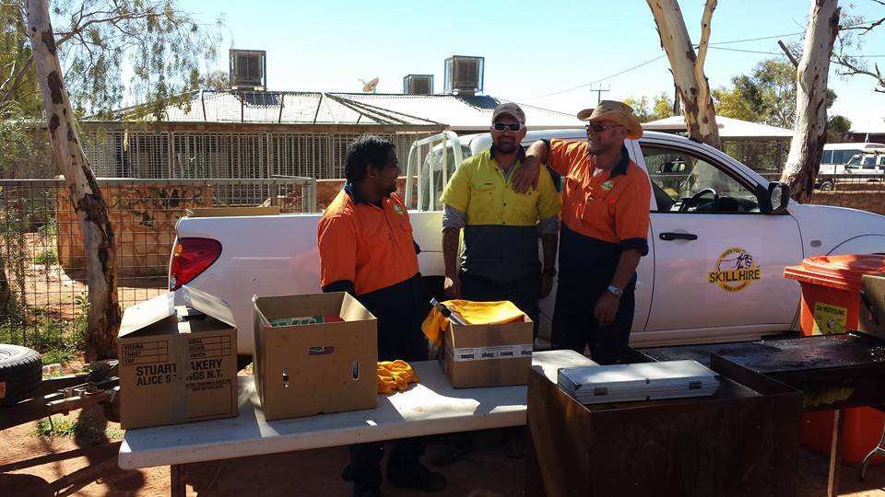
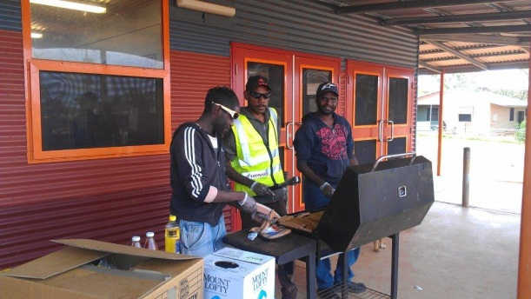
APY Lands - May 2014
Anangu Pitjantjatjara Yankunytjatjara (APY) located in the remote north west SA consists of the Pitjantjatjara, Yankunytjatjara and Ngaanyatjarra peoples (or “Anangu”) - population 2,500
Indulkana, Kaltjiti (Fregon), Umuwa, Mimili, Pukutja
Focus on lifting understanding with service providers
Where possible lift community awareness- BBQs
Work Skill team at Indulkina
Work Skill team at Mimilli

Slide 12
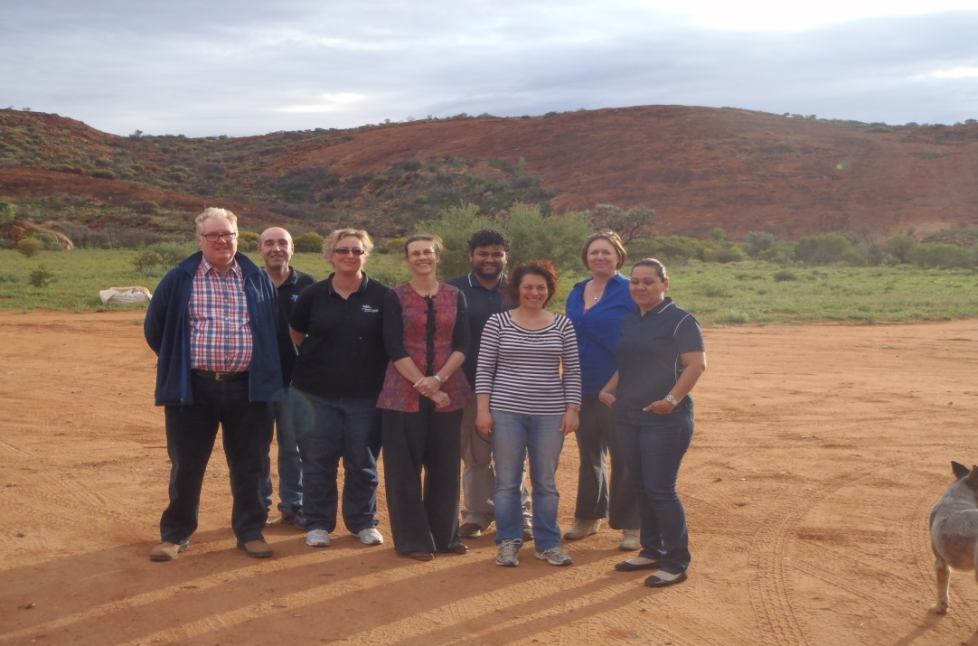
APY Lands- lessons learned
Local interpreters are important- English is the 3rd or 4th language spoken
Needed to work with local community health workers re DSP
community members are reluctant to question their centrelink payments for fear of reprisal or negative consequences to their payments
WRC & Money Mob- a useful trusted place for building financial literacy and get
advice on centrelink payments
Partnerships with DHS- important

Slide 13
APY lands - lessons learned
collective show from the organisations- Centrelink, SSAT, AAT, WRC, BINSA. Show a complete story - there is no problem with challenging Centrelink decisions
community members may be nomadic making regular points of communication difficult. Often only one public phone in the community. You have to make special arrangements to call people and get messages to people. Communication with the local community centre
Have to be adaptive to changing situations- football games, going fishing, community activities, sorry business

Slide 14
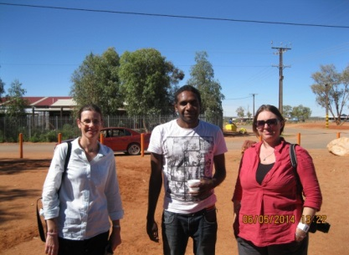
APY Lands Lessons learned
The art centres are key places - important for getting information out to the community
Catering for service providers in small meetings encourages engagement
Organising a service providers meeting before or after the education session works well.
Handouts in English are OK, but posters in local indigenous languages are essential with simple messages.
Know local shop opening hours
Make sure all staff have completed cultural awareness training and practice it.
These are long term strategies- it takes time to build relationships and see results

Slide 15
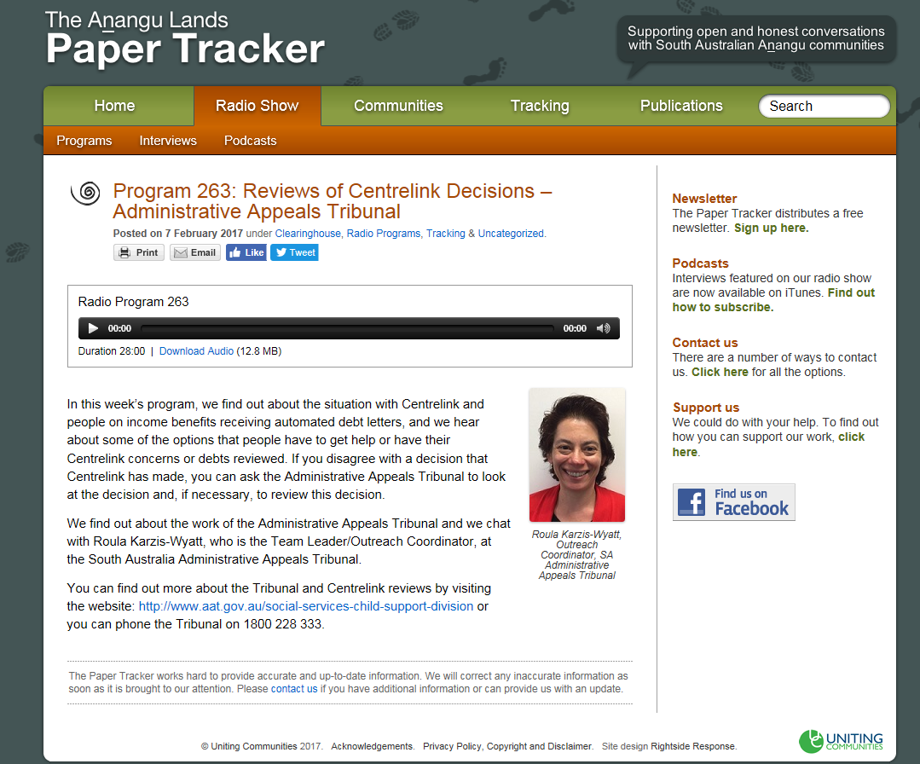
On the radio
Radio Tracker 2017
Interviewed by Radio Tracker as part of a series of interviews with WRC and Money Mob
Interview was translated into Anangu.
Posted on the radio
paper tracker
website + transcript and
written information

Slide 16
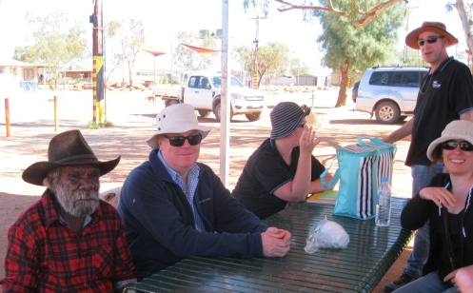
Benefits
Low cost ventures- car hire, accommodation and staff time- shared between stakeholders organisations
High level engagement from service providers and community Elders
Requests for return visits by service providers
Form strategic relationships with service providers
Demystify the role of the AAT
Improve services to clients/ tribunal users
Higher numbers of appeals from regional and remote areas
Greater number of non legal representatives participating

Slide 17
The future
New strategic relationships to be formed
Working to develop posters for remote indigenous communities
Using new and existing communication channels- NBN provides opportunities?
These relationships take time and effort and years to form. They have to be renewed and enhanced due to turn over in staffing and customers.

Slide 18
Overall lessons learned
Building and establishing key stakeholder relationships is crucial
Always plan & prepare and manage risk- work with local service providers to maximize efficiency and effectiveness of visits and training- gain local intelligence
Adapt to changing circumstances- plan for best and expert the worst- sound risk management and WHS
Show the AAT review process is part of the review spectrum – original decision maker, ARO and first and second level AAT review

Slide 19
Conclusions
They are long term strategies
It does not take a lot of resources to undertake these activities
Passion and commitment is key
They improve access to justice
Building relationships is the key

