Slide 1
Natural Justice and Registered Health Practitioners
Elizabeth Kennedy
General Counsel and Corporate Secretary
Peter MacCallum Cancer Centre
COAT Victoria Conference 22 April 2016

Slide 2
Natural Justice and Procedural Fairness
Per Mason J in Kioa v West [1985] HCA 81
“It has been said on many occasions that natural justice and fairness are to be equated : see e.g Wiseman v Borneman: Bushell v Secretary of State for the Environment” And it has been recognized in the context of administrative decision-making that it is more appropriate to speak of a duty to act fairly or to accord procedural fairness”.
[but the Health Practitioner Regulation National Law requires natural justice to be observed]

Slide 3
Doctors are different…
Section 41 (2) of the Health Services Act 1988 (Vic)
The board of a public hospital or denominational hospital must not dismiss or suspend any registered medical practitioner employed or engaged by the hospital unless the board—
(a) where there has been an allegation against the registered medical practitioner, inquires into any matter alleged; and
(b) gives the registered medical practitioner an opportunity to be heard.

Slide 4


Slide 5
Complaints about health practitioners abound!
“Low level”-to Hospital, e.g. practice manager OR
To Health Services Commissioner
[Note new Health Complaints Bill 2016 (Vic) -Health Complaints Commissioner –new statutory entity] OR
To AHPRA –called a “notification” under Health Practitioner Regulation National Law (Victoria) Act 2009
Mandatory or voluntary?
[Note: relationship between AHPRA and health complaints entity-mechanism to decide who investigates-see s. 150 Health Practitioner Regulation National Law (Victoria) Act 2009

Slide 6
Mandatory Reporting
From 1/7/10 under the Health Practitioner Regulation National Law notifiable conduct, in relation to a registered health practitioner, means the practitioner has -
(a) practised the practitioner's profession while intoxicated by alcohol or drugs; or
(b) engaged in sexual misconduct in connection with the practice of the practitioner's profession; or
(c) placed the public at risk of substantial harm in the practitioner's practice of the profession because the practitioner has an impairment; or
(d) placed the public at risk of harm because the practitioner has practised in a way that constitutes a significant departure from accepted professional standards

Slide 7
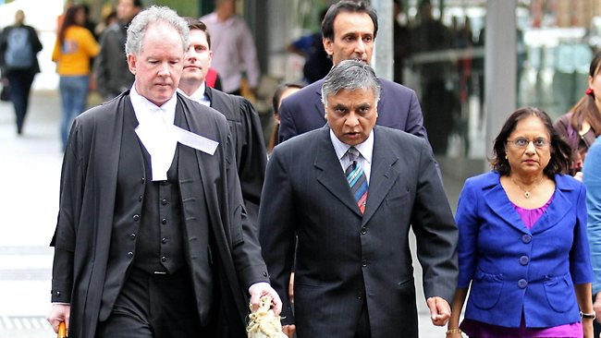

Slide 8
Health Practitioner Regulation National Law (Victoria) Act 2009
Notification to AHPRA may be verbal or in writing
Preliminary assessment
“Frivolous, vexatious, misconceived or lacking in substance”?
Or “as soon as practicable” written notice to the registered health practitioner or student “advising of the nature of the notification” see s. 152
Note: despite this, a National Board is not required to give notice of the notification if it reasonably believes it would “prejudice the investigation” or place at risk a person’s “health or safety” see s. 152(3)

Slide 9
Actual experience of this with NBV
Midwife was suspended in circumstances of a stillbirth
Anonymous notification to NBV
Attempted home birth of twins where woman had presented to Hospital at 38 weeks in breech position
Serious departure from accepted professional standards such as to endanger life
Previous notifications
Under Section 40 (1) (c) of the Health Professions Registration Act 2005 (Vic) no requirement to notify midwife until after suspension if health and safety will be endangered

Slide 10
Annetts v McCann [1990] HCA 57; (1990) 170 CLR 596
“It can now be taken as settled that, when a statute confers power upon a public official to destroy, defeat or prejudice a person's rights, interests or legitimate expectations, the rules of natural justice regulate the exercise of that power unless they are excluded by plain words of necessary intendment”

Slide 11
Commissioner of Police v Tanos (1958) 98 CLR 383
Per Dixon C.J. and Webb J. (at p 396)
“an intention on the part of the legislature to exclude the rules of natural justice was not to be assumed nor spelled out from "indirect references, uncertain inferences or equivocal considerations".

Slide 12
AHPRA performance and professional standards panels
S.185 of the National Law provides that a Panel may decide its “own procedure”
And clearly provides that a Panel is required to “observe the principles of natural justice but is not bound by the rules of evidence”
Legal representation is by leave of the Panel –s. 186
A hearing is not open to the public s. 189
As soon as practicable after making a decision a panel must give notice to the National Board and the Board must within 30 days give written notice to the registered health practitioner (and if applicable to the notifier)

Slide 13
Panels established by a National Board
Under s 181 of the Health Practitioner Regulation National Law a National Board may establish a health Panel if the notification suggests a health practitioner has an impairment
Or if there is an issue of performance and or professional standards-see s 182
Under s 182 (6) a person may not be appointed if the person has been involved in any proceedings relating to the matter the subject of the hearing

Slide 14
Natural Justice and Panel hearings
From the Guide to the Conduct of Panel Hearings (3rd edition) published by AHPRA June 2014
“While the rules of natural justice are not fixed the twin pillars of natural justice require that the practitioner or student has an opportunity to be heard and compliance with the rule against bias”
Hearing rule requires the giving of notice to the practitioner or student, and reasonable notice of the time and place of hearing and an opportunity to make written submissions

Slide 15
Bias
The rule against bias requires a Panel member to have an open mind
Panel members must declare before the hearing whether they know the practitioner or student
The rule against bias means the decision maker must be fair impartial and free from bias
Cannot bring prejudice or a predetermined opinion about the practitioner or student to the hearing
[Apprehended bias is when an informed fair-minded observer would infer that the decision maker might be biased See Ebner v Trustee in Bankruptcy [2000] HCA 63]

Slide 16
Other examples e g. RACS policy
The policy of the College Dismissal from Surgical Training highlights the policy of the College that all decisions, particularly in relation to dismissal, must observe the rules of natural justice.
College Position Paper “Natural Justice – Guidelines for Decision Makers” provides:
“… the decision maker should not be or include any person who has taken part in any prior related substantive decision affecting the individual …which would preclude or be perceived to preclude them from dealing with the matter with an open mind”

Slide 17
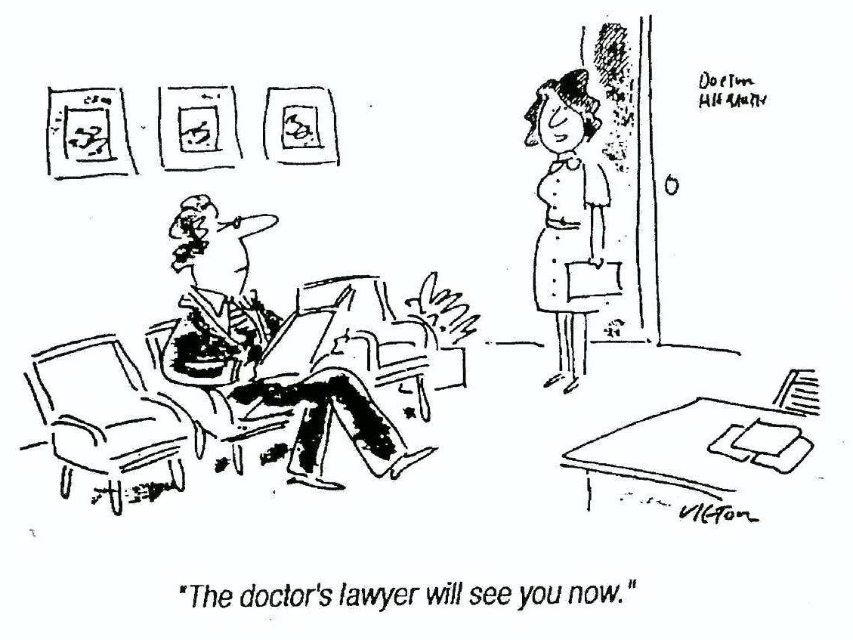
Questions…

