Slide 1

Applying the Framework for Tribunal Excellence
& Measuring Performance
Mike Vallance
Manager, International Framework for Court Excellence, Supreme Court of Victoria
and
Manager, International Framework for Judicial Support Excellence, Court Services Victoria

Slide 2
Applying the Framework for Tribunal Excellence
& Measuring Performance
The Formula for Success
The extent to which a tribunal’s most senior leaders actively support the Framework will be directly proportional to the benefits derived from its use
A visible and consistent commitment by tribunal leaders is a pre-requisite to gaining the true value from applying a management and improvement model such as the Framework

Slide 3
Applying the Framework for Tribunal Excellence
& Measuring Performance
Delivering Important Public Value
[why the Framework is a valuable tool]
Tribunal Values and Culture
[a fundamental of tribunal excellence]
Measuring and Managing Performance
[the mark of an excellent tribunal]

Slide 4
Applying the Framework for Tribunal Excellence
& Measuring Performance
Delivering Important Public Value
[why the Framework is a valuable tool]

Slide 5
Delivering Important Public Value
Putting the Framework into Perspective
Delivering important public value is the most significant outcome for all tribunals, regardless of jurisdiction or environment
Usually = ‘the quick, cheap and relatively informal resolution of disputes’
To sustain delivery of important public value all tribunal operations must be second to none
To successfully deliver important public value tribunal leaders will need the assistance of management tools

Slide 6
Delivering Important Public Value
Area-Specific Management Tools
Knowledge Management Framework
Project Management Framework
Performance Management Framework
The Balanced Scorecard
Customer Service Framework
The Stakeholder Model
Risk Assessment Framework
Information Management Framework
Competency Framework
Governance Framework
Compliance Framework
Leadership and Management Framework

Slide 7
Delivering Important Public Value
The ‘holistic’ nature of the Framework
Recommends tribunals examine (or assess) all operations at the same time;
and, based on this balanced view, prioritise improvement efforts
Binds area-specific frameworks into a single, clear management approach
Transitions tribunals from being ‘tribunal-centric’ to being ‘service-centric’
Elevates importance of the Framework to simply being:
‘the way we do things around here’

Slide 8
Delivering Important Public Value
The way we do things around here - it all fits
Knowledge Management Framework Area 5
Project Management Framework Area 2
Performance Management Framework Area 2, 6, 7 & 8
The Balanced Scorecard Area 2, 6, 7 & 8
Customer Service Framework Area 6 & 8
The Stakeholder Model Area 6 & 8
Risk Assessment Framework Area 2
Information Management Framework Area 4 & 7
Competency Framework Area 3 & 5
Governance Framework Area 1 & 2
Compliance Framework Area 1, 2 & 6
Leadership and Management Framework Area 2

Slide 9
Delivering Important Public Value
Tribunal Independence
The Framework suggests that tribunals, as part of the Executive, have to fight hard to look and be independent from their host departments
The Framework suggests tribunal users and the community would expect excellence and the responsible Minister would demand excellence
To be as independent from your host department as possible, you must be able to demonstrate that you can competently manage your own affairs
If you show a clear management approach that binds all operations together in the pursuit of ‘excellent’ important public value, the government of the day is far less likely to interfere in your tribunal’s affairs

Slide 10
Applying the Framework for Tribunal Excellence
& Measuring Performance
Tribunal Values and Culture
[a fundamental of tribunal excellence]

Slide 11
Tribunal Values and Culture
Patrick M. Lencioni, founder and president of the Table Group from Emeryville, California
who wrote an article for the Harvard Business Review titled “Make Your Values Mean Something”
Corporate values from Enron’s 2000 Annual Report
Communication
We have an obligation to communicate
Here, we take the time to talk with one another and to listen
We believe that information is meant to move and that information moves people
Respect
We treat others as we would like to be treated ourselves
We do not tolerate abusive or disrespectful treatment
Integrity
We work with customers and prospects openly, honestly and sincerely
When we say we will do something, we will do it; when we say we cannot or will not do something, then we won’t do it
Excellence
We are satisfied with nothing less than the very best in everything we do
We will continue to raise the bar for everyone
The great fun here will be for all of us to discover just how good we can really be

Slide 12
Tribunal Values and Culture
The Australia and New Zealand Tribunal Excellence Framework
Framework suggests the two fundamentals of tribunal excellence are:
The Core Tribunal Values
The Eight Areas of Tribunal Excellence
Framework lists ten core tribunal values, indicating:
COAT considers there are core values that tribunals should uphold and apply in carrying out their function of dispute resolution
Framework does not make one reference to values in any of the 95 questions listed in its proposed self-assessment questionnaire

Slide 13
Tribunal Values and Culture
The Challenge of Values
This brings me to one of the weightiest, and possibly controversial, implications associated with adoption of the Framework
If your tribunal is not willing to accept the discomfort real values can cause, don’t bother going to the trouble of formulating a values statement
You’ll be better off without one
But, if you have the fortitude to see the effort through, adopting meaningful corporate values as part of your implementation of the Framework can have a profound effect on the formation of your preferred tribunal culture

Slide 14
Tribunal Values and Culture
Basic Imperatives for Successful Values
1 - Tribunal leaders must understand the different types of values
  Core values
  Aspirational values
  Social values
  Accidental values
2 - Tribunal leaders must be aggressively authentic
3 - Tribunal leaders must own the values process
4 - Tribunal leaders must weave the core values into everything

Slide 15
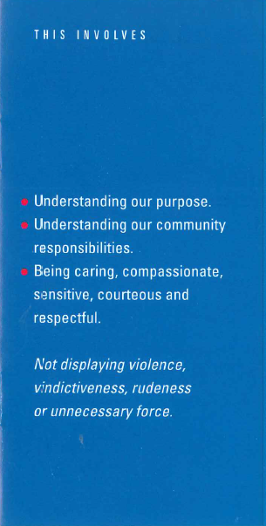
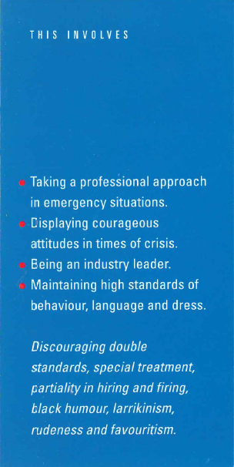

Tribunal Values and Culture
An Example of Successful Values
Customer Commitment
Professionalism
Personal Integrity

Slide 16
Applying the Framework for Tribunal Excellence
& Measuring Performance
Measuring and Managing Performance
[the mark of an excellent tribunal]

Slide 17
Measuring and Managing Performance
The Australia and New Zealand Tribunal Excellence Framework
Area 2 - Tribunal Leadership and Effective Management
Excellent tribunals will review performance and publish results, including current performance levels, relative to targets and/or benchmarks
Area 6 - Accountability
Reporting a tribunal’s performance against established benchmarks is a mark of an excellent and accountable tribunal
Area 7 - Efficiency
A tribunal will need to determine performance measures and benchmarks which might include timeliness; a system of monitoring delayed cases and backlogs; and whether hearings start on time
Area 8 - Client Needs and Satisfaction
User satisfaction should be regularly measured

Slide 18
Measuring and Managing Performance
Why performance management?
Courts that are in fact well run and are perceived to be well run
are more likely to be well funded; even in periods of tight budgets.
The rest will most likely be told to do more with less
from the High Performance Court Framework used by the State Courts in the US
The financial challenge tribunals face today demands creative thinking
Tribunals that will flourish are those willing to implement changes they may not even have considered in the past
Creative thinking benefits from the availability of
meaningful performance information

Slide 19
Measuring and Managing Performance
What is performance management?
Defined as:
The process of monitoring, analysing and using performance data on a regular basis to improve
the quality of services
Effective performance management will help tribunals identify problems early in their formation and facilitate getting the information to tribunal leaders before the problems fester, spread or boil over
Successful performance management is a dynamic process that helps tribunal leaders to think critically and creatively as well as to explore alternative ways to solve problems

Slide 20
Measuring and Managing Performance
Outputs, Outcomes and Benchmarks
Output measures inform how busy a tribunal is, not how well it is performing
i.e. the tribunal finalised 745 hearings in 2016-17
(a tribunal-centric measure)
Outcome measures gauge the impact of a tribunal’s service on its community
i.e. the tribunal finalised 80% of its hearings within 12 months
against a target of 75%
(a service-centric measure)
A measure without a benchmark or target is just a number
i.e. the tribunal achieved a 103% clearance rate
versus
the tribunal achieved a 103% clearance rate against its benchmark of 100%

Slide 21
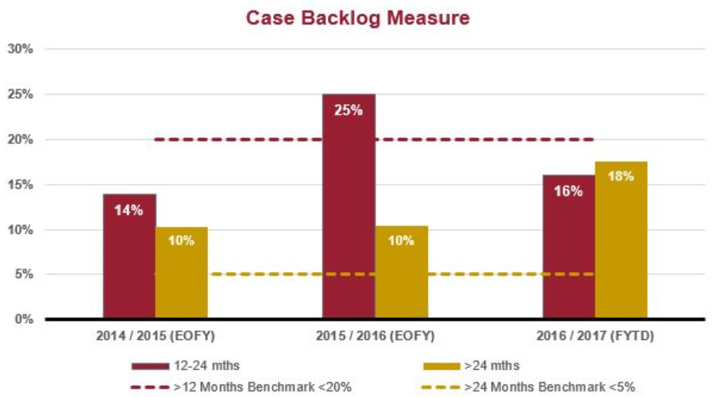
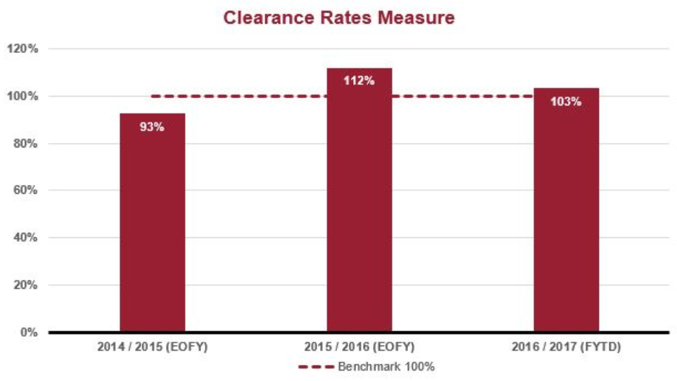
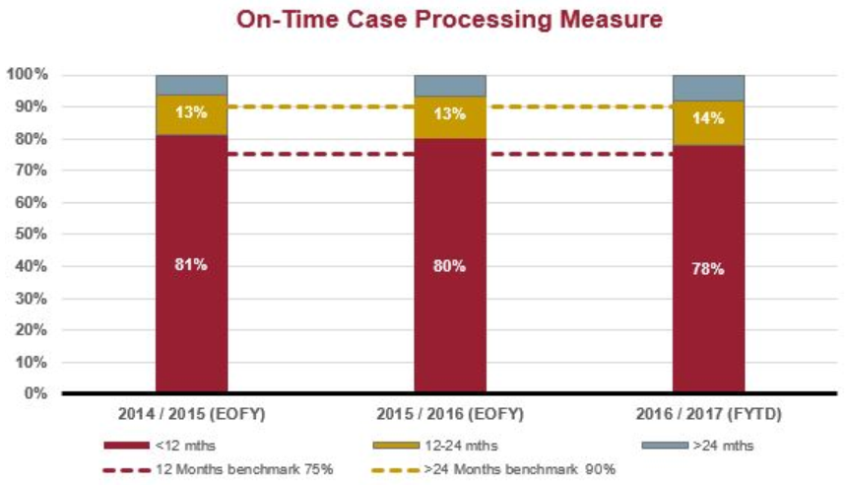
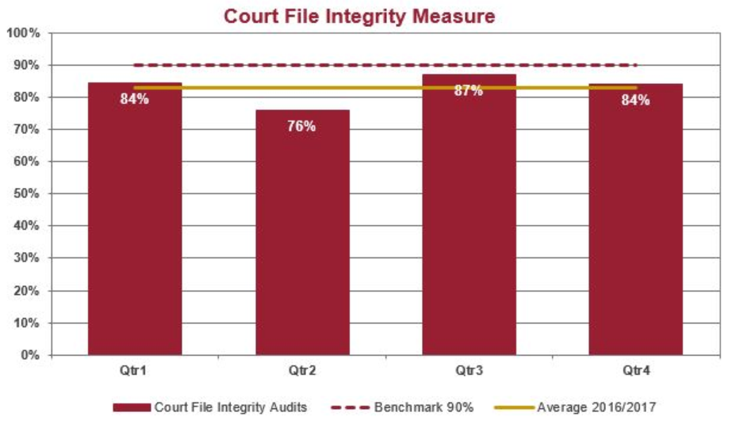
Measuring and Managing Performance
An Example: Supreme Court of Victoria

Slide 22
Applying the Framework for Tribunal Excellence
Conclusion
There are multiple, compelling reasons for a tribunal to apply the Framework
This presentation has addressed a few of the more challenging reasons
No tribunal is sustainable unless it pursues a structured management approach that helps to produce consistent and reliable outcomes
Tribunal leaders need to choose an approach that gives them, and their tribunal, the best chance of delivering important public value that meets their community’s expectations
Changing or disjointed management approaches adversely impacts the consistency and reliability of outcomes; and the efficiency of operations
Once a management approach is selected, stick with it until you have reaped all of its rewards; or until your tribunal’s maturity has outgrown it

Slide 23
Applying the Framework for Tribunal Excellence
& Measuring Performance
Mike Vallance
Manager, International Framework for Court Excellence, Supreme Court of Victoria
and
Manager, International Framework for Judicial Support Excellence, Court Services Victoria
Thank You

