Slide 1
Effective Questioning for Eliciting Information from Witnesses in Tribunal Hearings
Angela Dixon, PhD
Children’s Hospital at Westmead
Sydney, Australia

Slide 2
“Judge a man by his questions rather than by his answers.”
Voltaire
Pierre-Marc-Gaston, duc de Levis

Slide 3
A solution-focused approach – why?
Aims to engage participants in hearings as active partners in the discussion and decision-making process of a court and tribunal.
Based on the premise that the best outcomes are achieved when participants are key players in the formulation and implementation of plans to address the underlying issues.

Slide 4
Communication
Barriers to communication
  Current mental state
  Stress levels
  Personality factors
  Cultural differences

Slide 5
“to participate effectively in tribunal hearings depends on their capacity at the time, as well as their understanding of the tribunal’s function, their emotional state and the opportunity they are given to contribute”
Carney et al, 2011

Slide 6
Competency areas
Forms of speech
Body language
Listening skills

Slide 7
Strategies to promote effective and respectful dialogue
A judicial officer can use questions, statements, requests, single words or non-verbal prompts to promote dialogue with participants
The key is how to frame questions and other responses to avoid anti-therapeutic effects (Kings Bench Book)

Slide 8
Use of questions
Asking the right questions at the right time will help you gather better information, build stronger relations and manage people more effectively; it can also help to avoid misunderstandings and diffuse difficult situations.
A skilled questioner will have a clear strategy and formulate questions in advance. Questions that lawyers ask in interviews with clients, for example, will nearly always be non-leading questions but a good lawyer will know when to use another style of question.

Slide 9
Use of questions
There are some general guidelines that are always applicable:
  Ask only one question at a time
  Use simple words
  Use short questions
  Give the other person enough time to respond – they may need some thinking time

Slide 10
Use of questions
Leading questions
  Have limited use in hearings
  “you have problems with your treatment team, don’t you?”

Slide 11
Closed questions
usually receive a single word or very short, factual answer
are good for:
  Testing your understanding, or the other person's: "So, if I get this qualification, I will get a raise?"
  Concluding a discussion or making a decision: "Now we know the facts, are we all agreed this is the right course of action?"
  Frame setting: "Are you happy with the service from your bank?"

Slide 12
Use of questions
Open questions
  Are ideal
  Particularly WHAT and HOW questions
    “How are you?” What has been happening since your last hearing? How have you been coping?”
    “I see that you moved house recently. How is your new accommodation working out for you?”

Slide 13
Open questions
elicit longer answers
are good for:
  Developing an open conversation: "What did you get up to on vacation?"
  Finding out more detail: "What else do we need to do to make this a success?"
  Finding out the other person's opinion or issues: "What do you think about those changes?"

Slide 14
Use of questions
Avoid the “why” questions:
  Can be perceived as being a demand for explanation
  defensiveness
  Compare:
  “why did you stop your medication?” or “why didn’t you keep your appointment with your doctor”
  With:
  “I see that you stopped your medication/This report mentions that you missed an appointment with your doctor. What happened there?/How did that come about?

Slide 15
Asking questions about sensitive matters
Explain what information you require
Explain why you need the information
Ask permission to ask the question
Relate it directly to the legal issues if necessary.

Slide 16
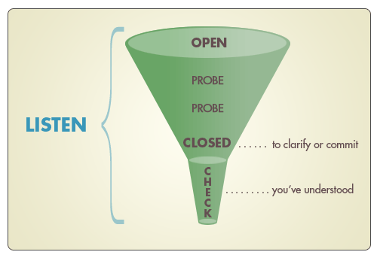
Funnelling

Slide 17
Funnelling
‘Tell me how you went about…?’ (open)
‘How did you prepare?’ (open – secondary)
‘What was your starting point?’ (probe)
‘So, what happened next?’ (probe)
‘Who else was involved?’ (probe)
‘And how did they respond?’ (probe)
‘What were your thoughts at that stage?’ (probe)
‘What were the main outcomes?’ (probe)
‘So, that took a total of six weeks?’ (closed – clarifying)
‘Was it your idea or someone else’s?’ (closed – clarifying)
‘And the patient made a full recovery?’ (closed – clarifying)
‘So, let me see if I’ve followed you…’ (checking – summary)

Slide 18
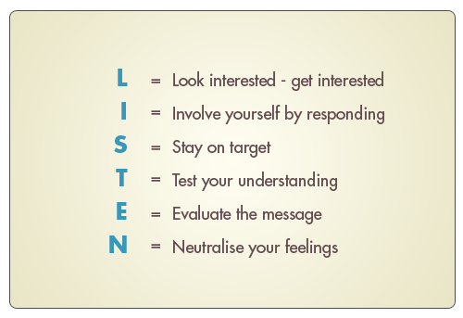

Slide 19
The use of single words or phrases
Can be an effective way of moving dialogue along:
  Participant: I used ice on Friday. It wasn’t good. I’ve been thinking about what I need to do
  Magistrate: What do you need to do?
  Participant: What I need to do is stop using

Slide 20
Making a statement
To avoid sounding accusatory, try:
  “I am not clear what brought about your relapse”
Rather than
  “Why did you relapse?”

Slide 21
Other solution-focused techniques
Paraphrasing
  Using your own words to repeat back to someone else what they have said
  Can be used to
    Clarify what has been said
    Demonstrate you have listened
    Demonstrates you care about what the participant thinks and feels
    Help the participant clarify their thoughts and feelings

Slide 22
Paraphrasing
“I started hearing the voices again for a while. But they changed my medication and I feel better now?
“so, you’re feeling better because you changed your medication, is that right?”

Slide 23
Supporting
Acknowledging and identifying with a person’s situation through
  Expressing empathy, agreement, praise, reassurance
  Positive versus negative feedback
    I’ve started working part-time and it’s going well so far
    Well done. What type of work are you doing?
    On discharge from an order
      Congratulations. You deserve it!

Slide 24
Speech and language
Avoid technical, legal and medical language
Avoid qualifying positive statements with “but”
  ‘It is great you stayed off drugs since your last appearance, but you missed an appointment with your counsellor.’

Slide 25
‘What I try to do is to get some sense of the person I’m talking to and how they would normally interact with other people and then work on those sorts of levels. We certainly are in an environment where there is lots of jargon around so trying to de-jargonise, particularly medical matters, is really important. Making sure people really do understand as best they can what’s going on is important. And that varies enormously.’
([former] Victorian MHRB President)

Slide 26
Speech and language
Exercise caution in using “you”
  Problematic: ‘How come you didn’t attend appointments with your case manager last month?’
  Better: ‘I’ve been told about some missed appointments with your case manager. What happened there?’
Use of “we” and humour
  Can promote a sense of collaboration
  Should not be used at the expense of participants

Slide 27
Practical listening skills
Ways in which listening can be impaired
  Note-taking and reading files during the hearing
    strategies
  Non-verbal body language
  Eye contact
  Facial expressions

Slide 28
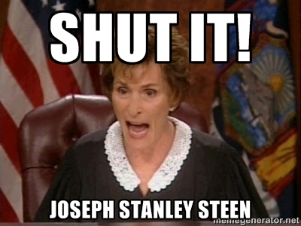
Blocking and interrupting
Exercise caution

Slide 29
But they didn’t seem to take very much notice of what I said.
What made you think that?
It was just their attitude. I wasn’t very happy at all. I felt I wasn’t allowed to talk. If I did talk it was just that they were just listening and that was all.
They weren’t hearing what you were saying? Is that what you mean?
Yes.
Was that something to do with their body language?
It was just the way that he kept saying ‘yes, yes, yes, yes’ to me. Sort of interrupting me when I was speaking. Yes we’ve heard that before from the person who advocated for me. Yet they asked me to speak. (Victorian consumer, v17).

Slide 30
Blocking and interrupting
Interrupt respectfully when necessary
  “you’ve made several points. I want to make sure I’ve understood them”
  Thank the person for talking about the particular topic, which is clearly important to them. Ask them to now focus on another important matter (a different topic).
  Be transparent about the limits of a hearing.

Slide 31
A final word…
Interpersonal communication varies according to the circumstances and the personalities, backgrounds and needs of the people involved. People may well vary in what they value in empathetic communication. It is therefore important that judicial officers be sensitive to the individual situation of the participant and what he [sic] is saying and to the uniqueness of the interaction between the bench and each participant.
(The Bench Book, Dr Michael King, 2009)

Slide 32
References
Effective questioning strategies and examples adapted from:
Mental Health Tribunal (2014). A guide to solution-focused hearings in the Mental Health Tribunal. Available at: http://www.mht.vic.gov.au/wp-content/uploads/2014/07/Solution-focused-hearings-guide.pdf
Carney, T., Tait, D., Perry, J., Alikki, V., & Beaupert, F., (2011). Australian Mental Health Tribunals: space for fairness, freedom, protection & treatment? Law and Justice Foundation of NSW, Adelaide.
King, M. (2009) Solution-focused judging bench book. Australasian Institute of Judicial Administration Incorporated, Melbourne.
NHS (2012) Skillful questioning and active listening – e-learning module. Available at: https://faculty.londondeanery.ac.uk/e-learning/appraisal/skilful-questioning-and-active-listening

